Slide 1

Classification and Visualization of Polyhedral Graphs via Degree Sequences
Research talk
Takumi Shiota
University of Hyogo, Japan
takumi_shiota@gsis.u-hyogo.ac.jp
June 11, 2025
@Maastricht university

Slide 2
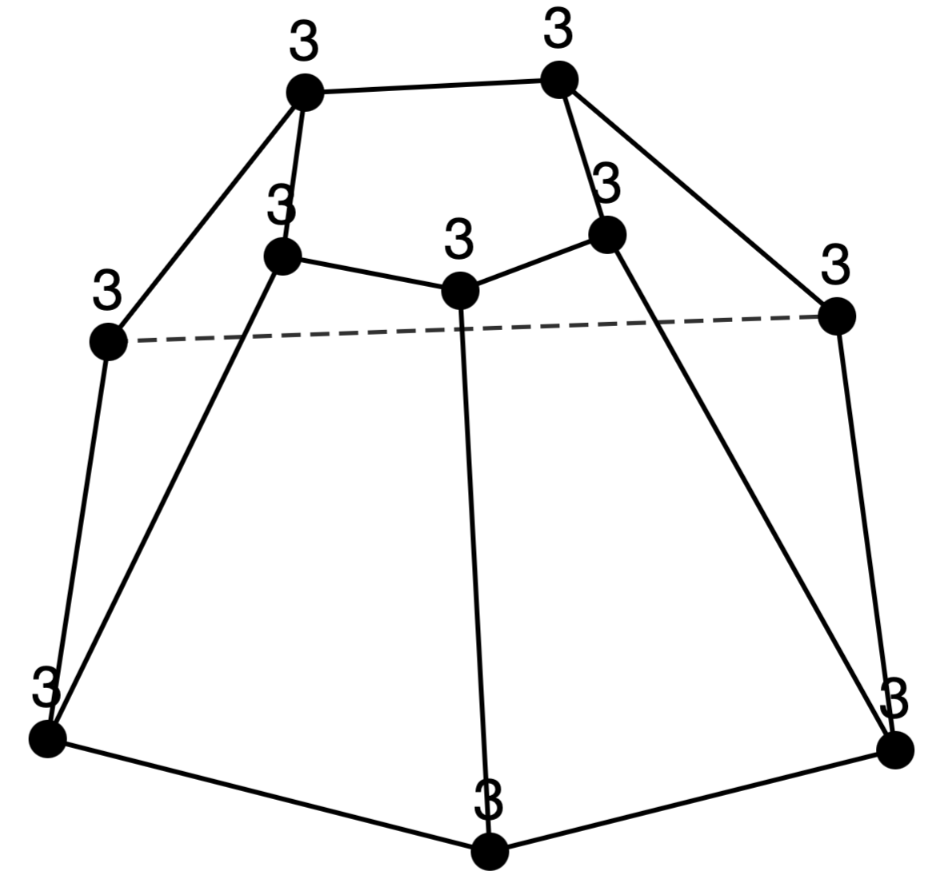
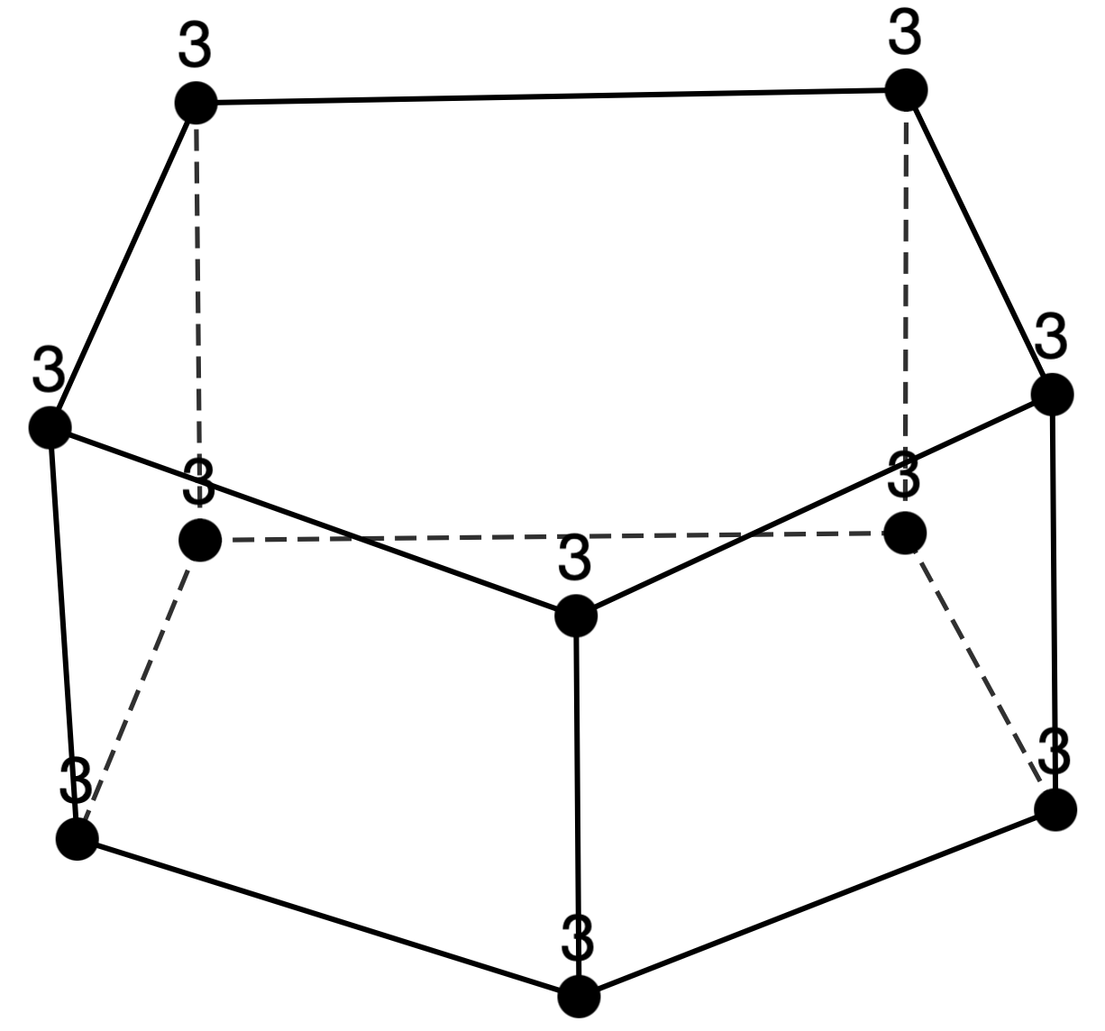
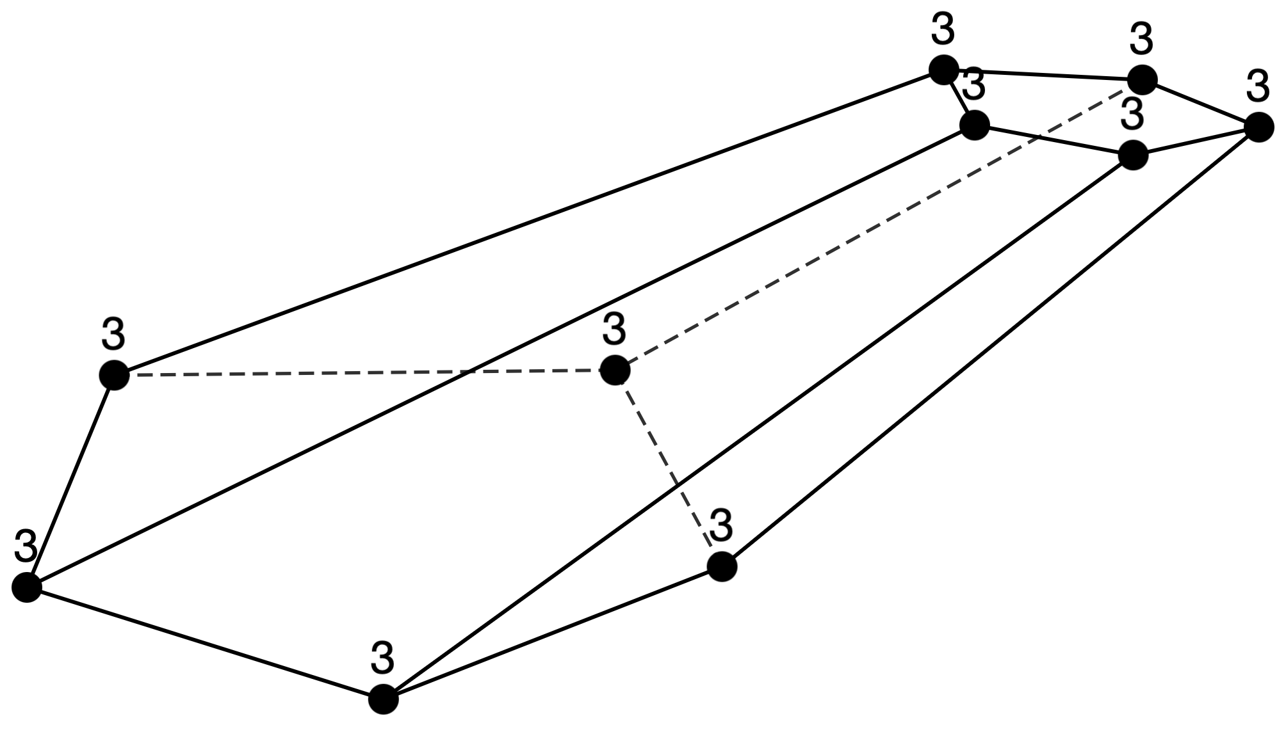
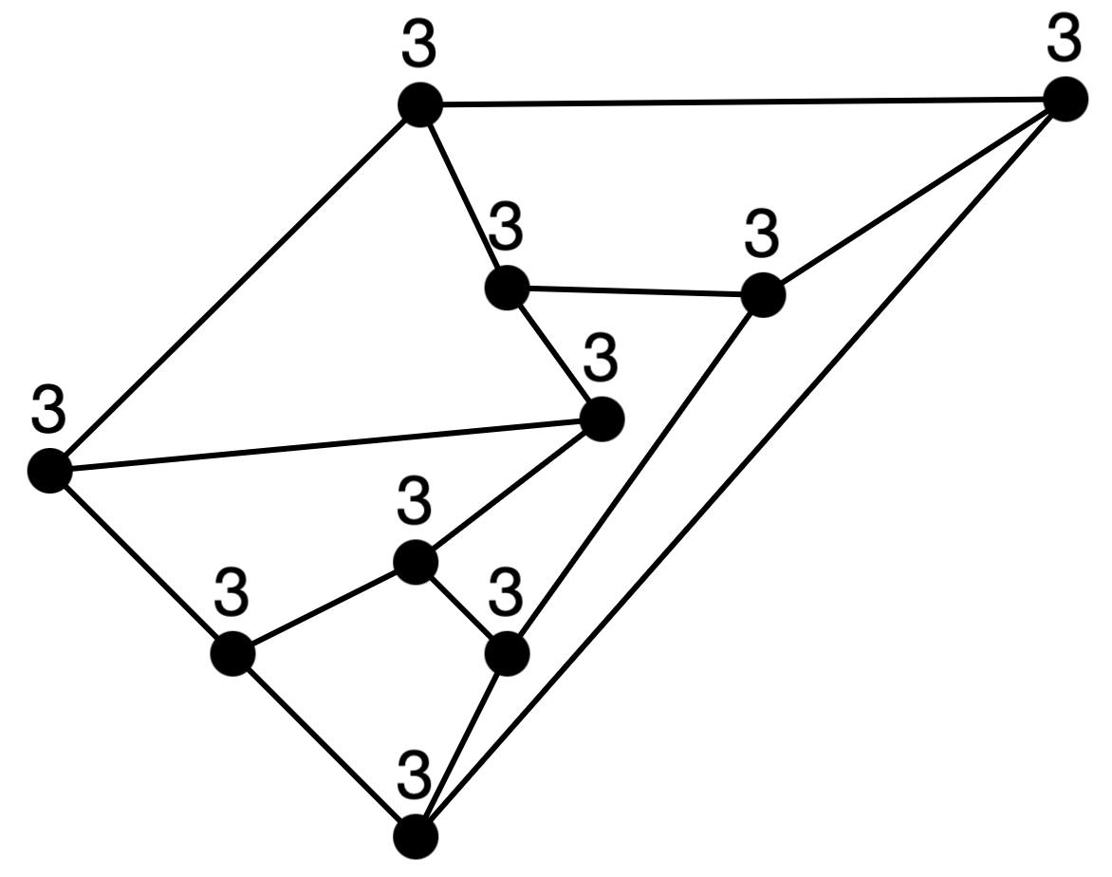
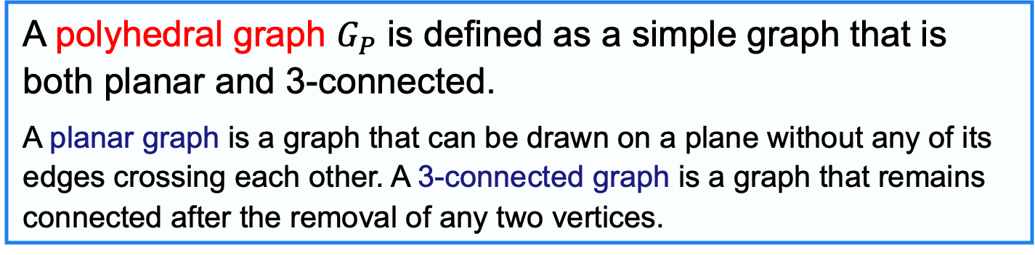
Polyhedral graph
Definition 1
A polyhedral graph $G_{P}$ is defined as a simple graph that is both planar and 3-connected.
A planar graph is a graph that can be drawn on a plane without any of its edges crossing each other. A 3-connected graph is a graph that remains connected after the removal of any two vertices.
Theorem 2 (Steinitz’s Theorem) [B. Grünbaum, 2003]
Every convex polyhedron can be represented by $G_{P}$.

Slide 3
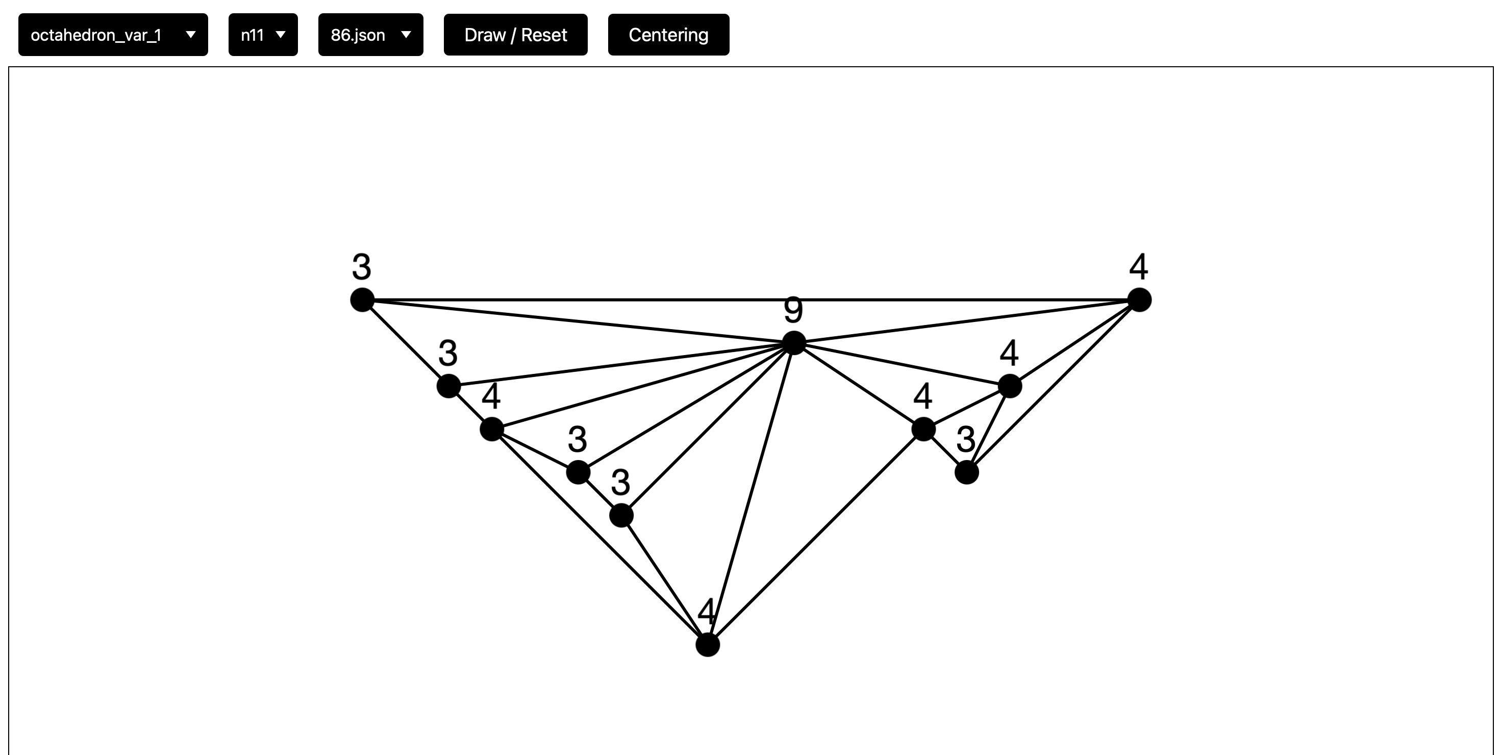
Research Results During My Stay
Result 1
We made a simple web application that allows free manipulation of edges and vertices in a polyhedral graph.

Slide 4
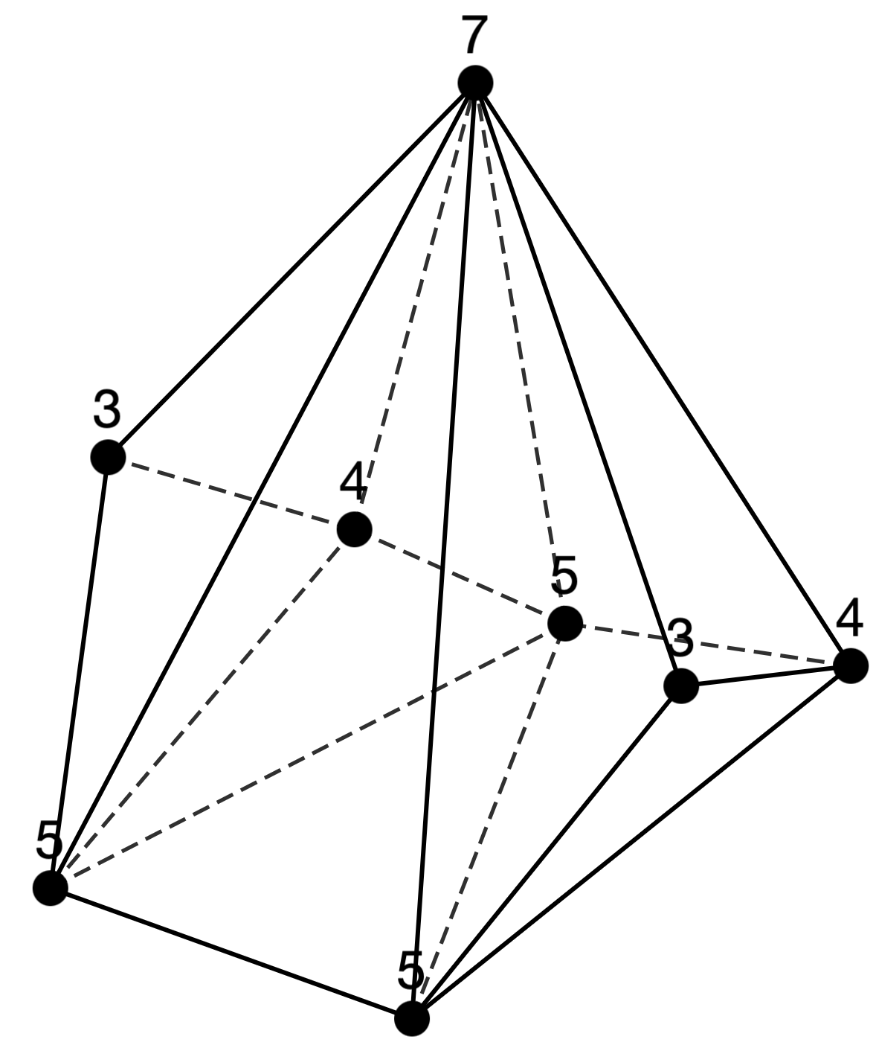
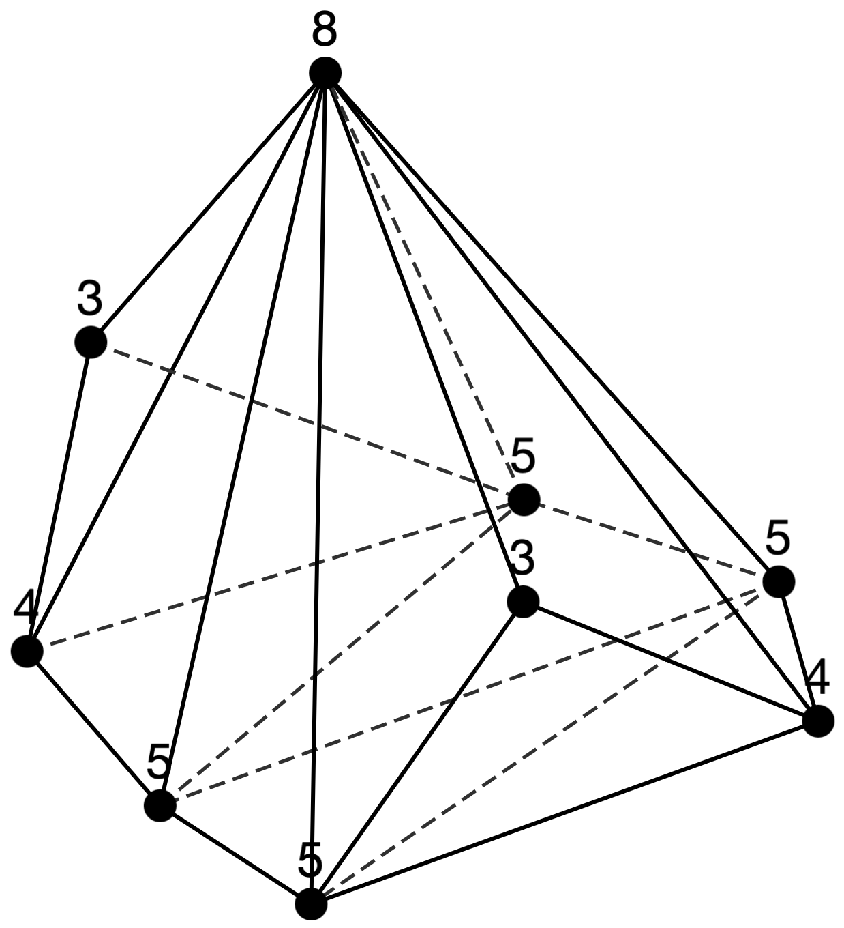
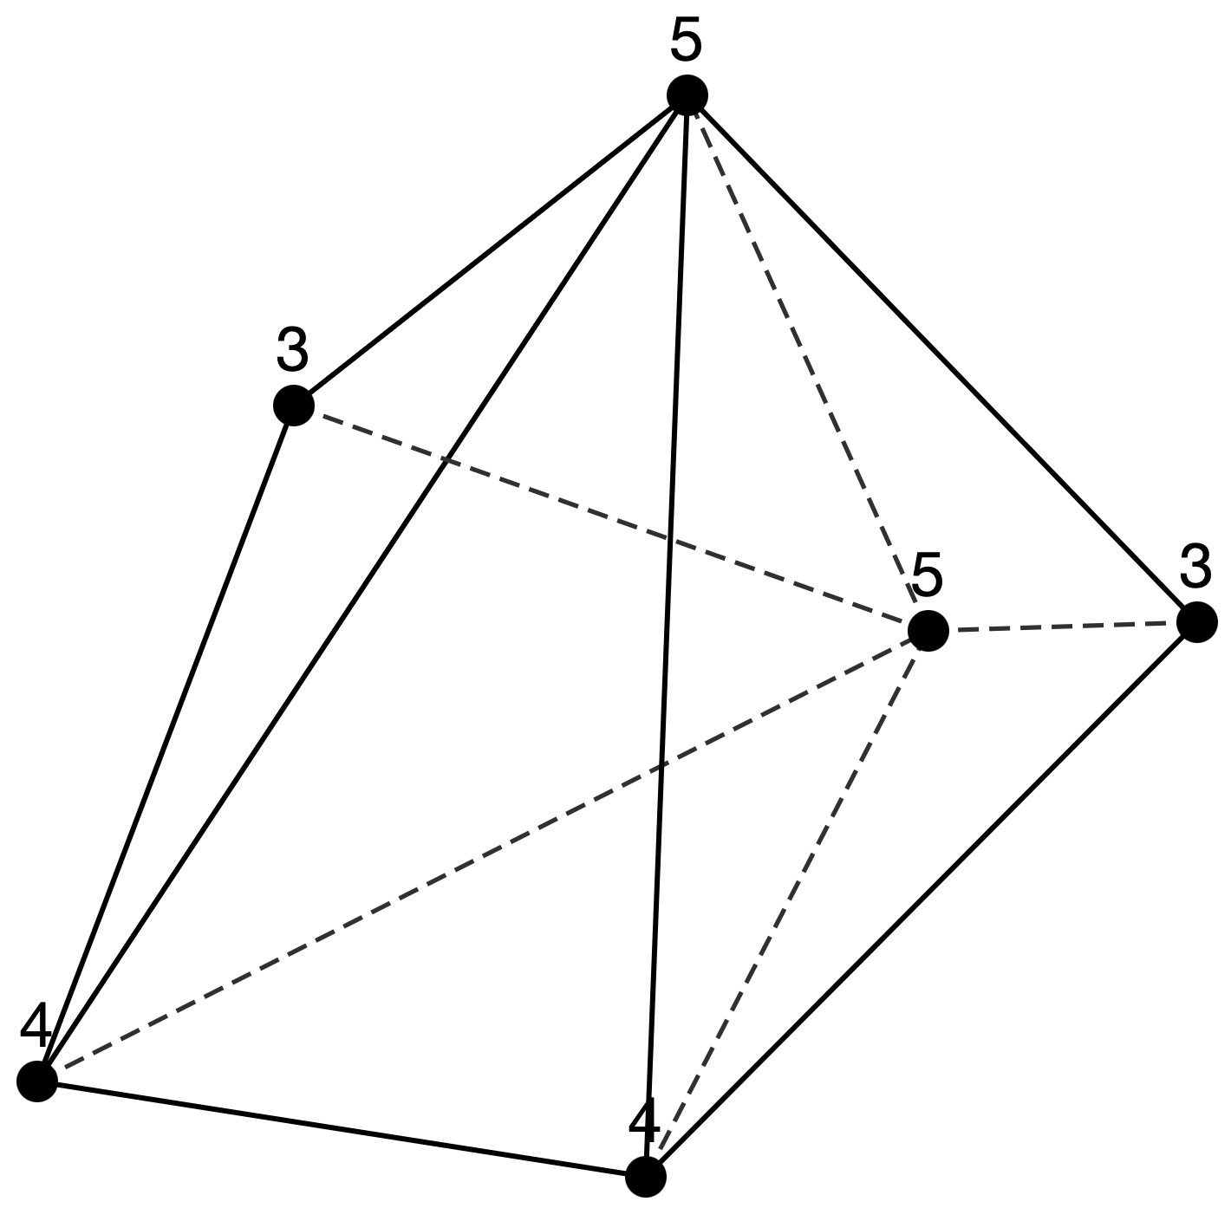
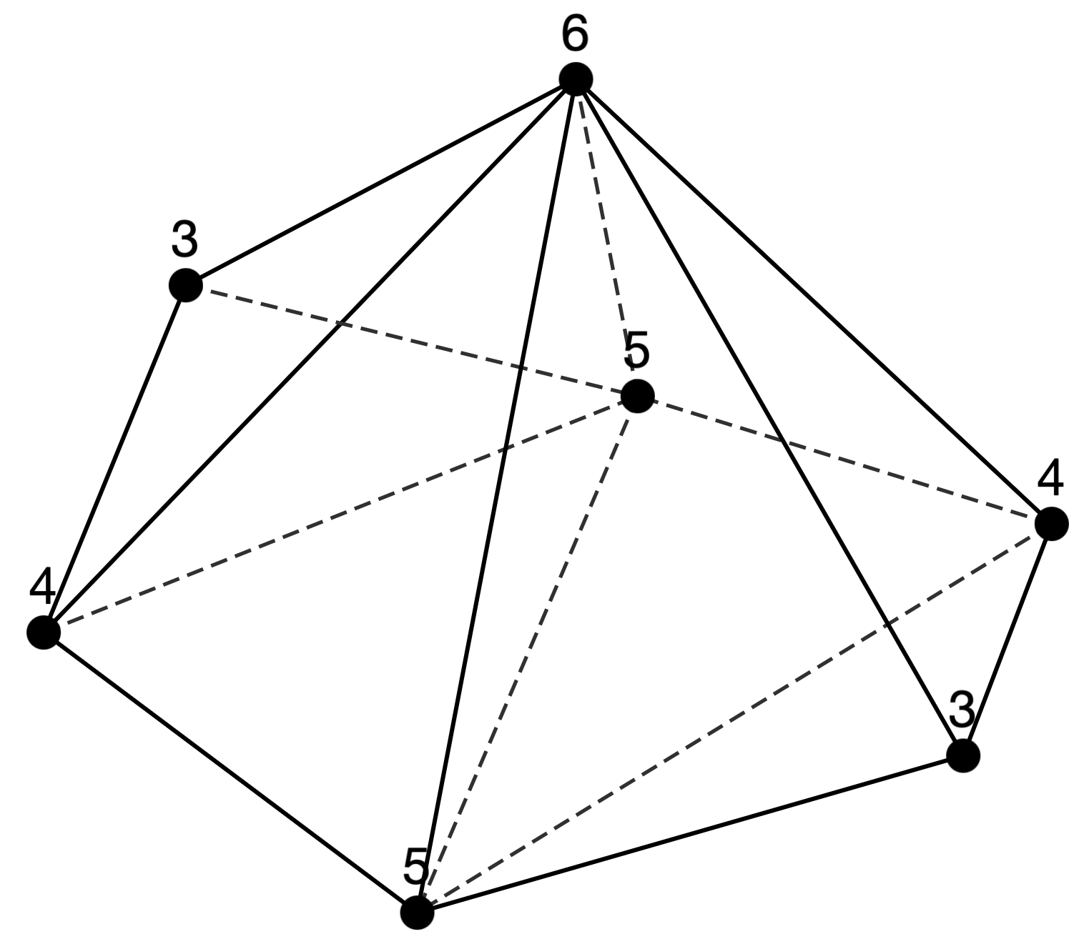
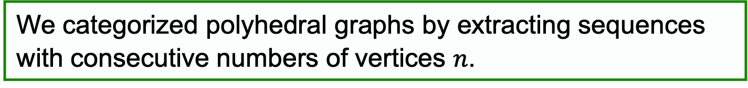
Research Results During My Stay
Result 2
We categorized polyhedral graphs by extracting sequences with consecutive numbers of vertices $n$.
n = 6
n = 7
n = 8
n = 9
Why did we want sequences of polyhedral graphs?
➡︎ From the following slides explain the background.

Slide 5
Edge Unfoldings
Definition 1 [E. D. Demaine and J. O’Rourke, 2007]
An edge unfolding of the polyhedron is a flat polygon formed by cutting its edges and unfolding it into a plane.
Cutting along the thick line of each left cube …
(a) Edge unfolding
(b) General unfolding

Slide 6

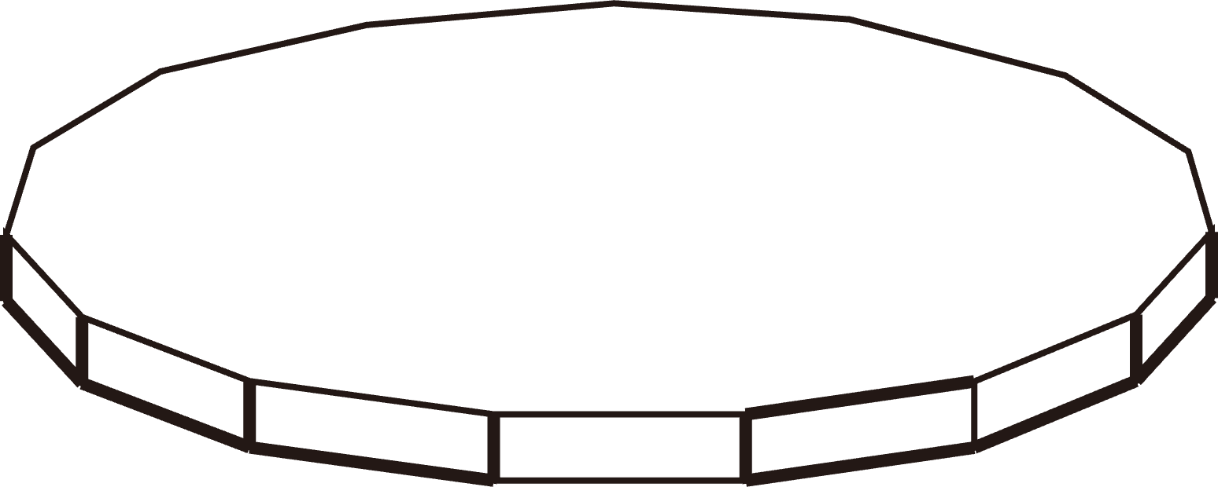


Overlapping Edge Unfoldings
Overlapping edge unfoldings exist in some convex polyhedra.
Truncated dodecahedron
[T. Horiyama and W. Shoji, 2011]
Truncated icosahedron
[T. Horiyama and W. Shoji, 2011]
$12$-gonal prism
[Schlickenrieder, 1997]
$15$-gonal prism
[Schlickenrieder, 1997]

Slide 7
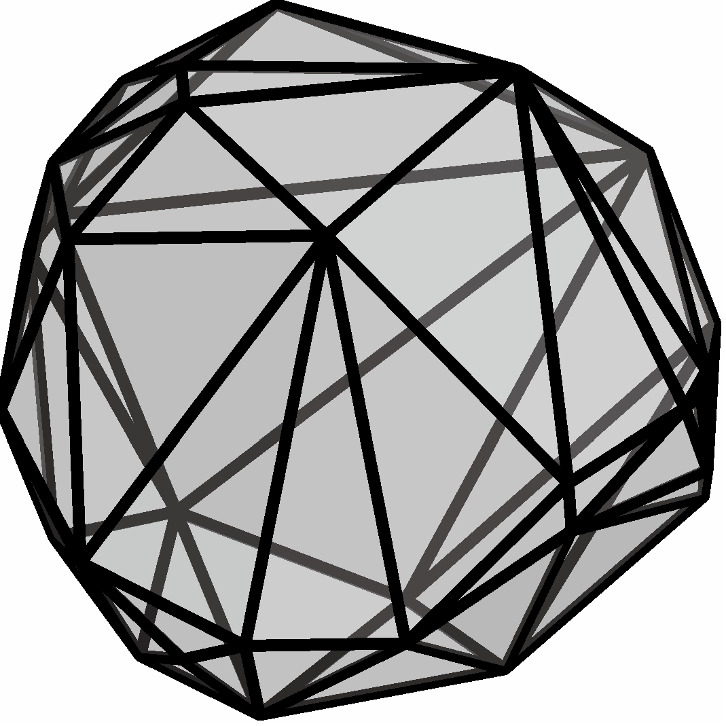
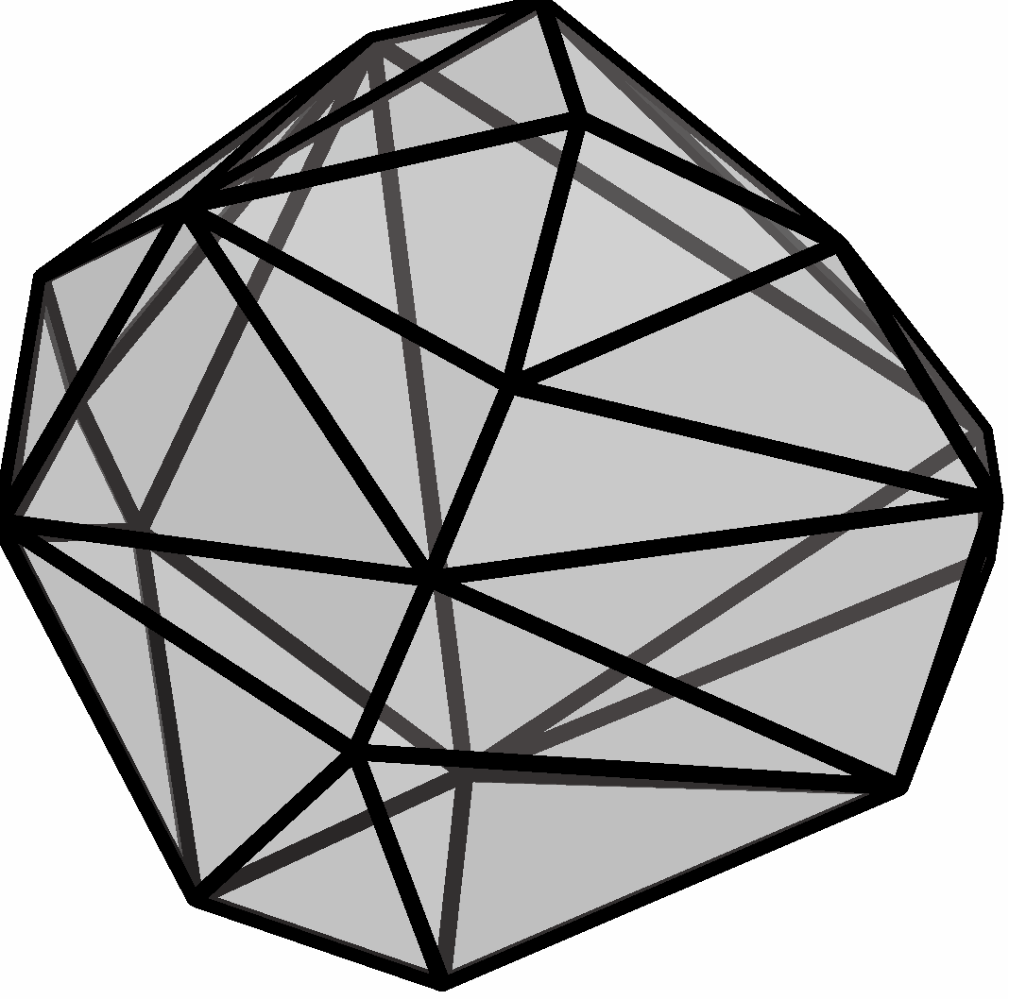
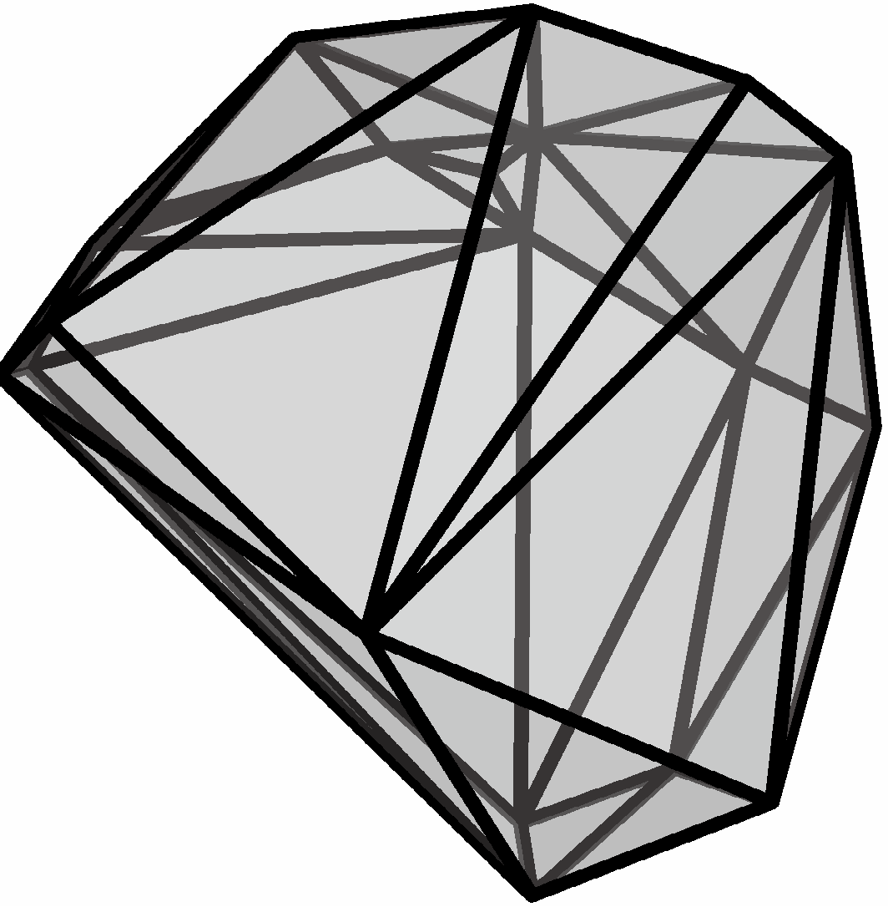

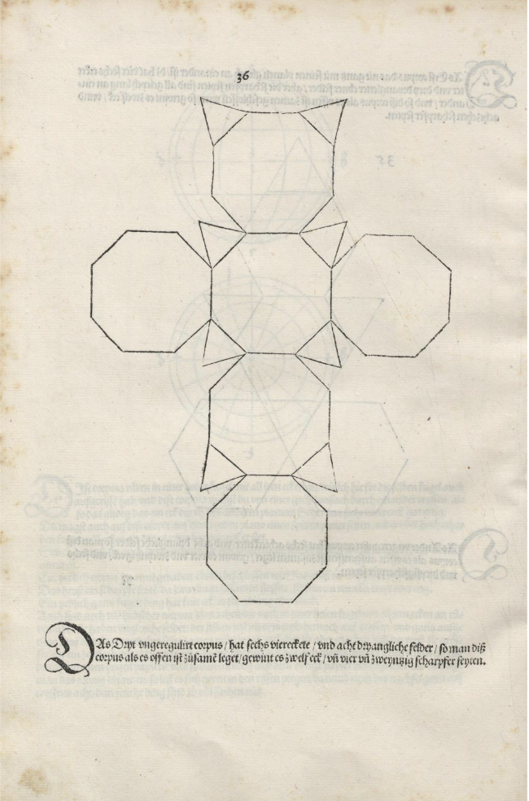
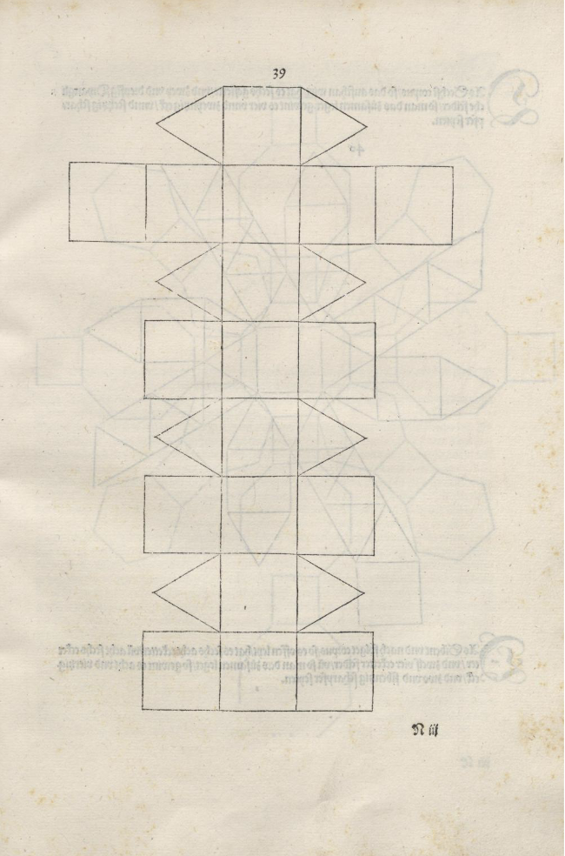
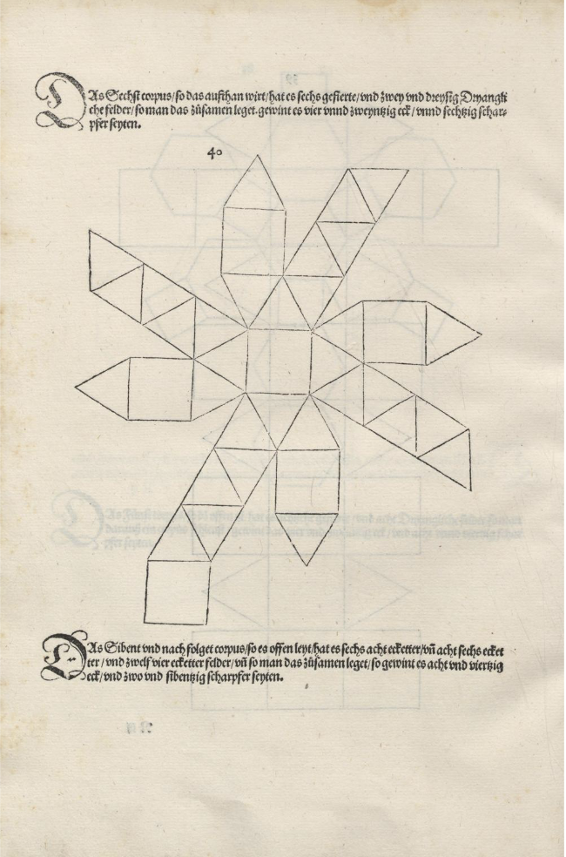
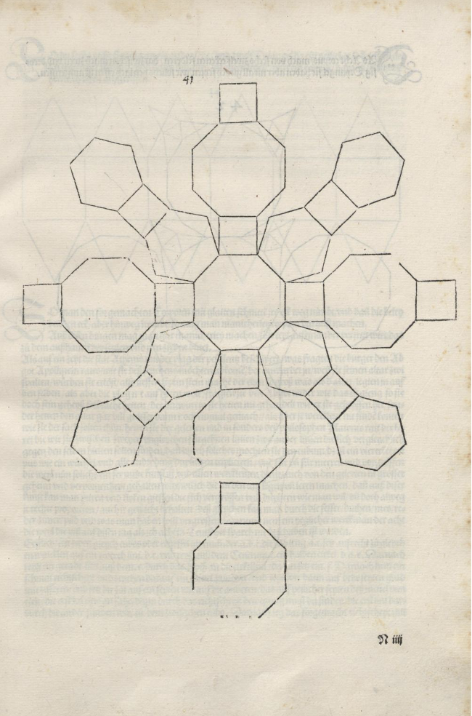
Research Motivation
Conjecture 2 [G. C. Shephard, 1975]
Can every convex polyhedron be edge-unfolded without overlaps?
[Albrecht Dürer, 1525] “Underweysung der Messung, mit dem Zirckel und Richtscheyt, in Linien Ebenen unnd gantzen corporen”
Conjecture 2 is called “Dürer’s Problem”

Slide 8
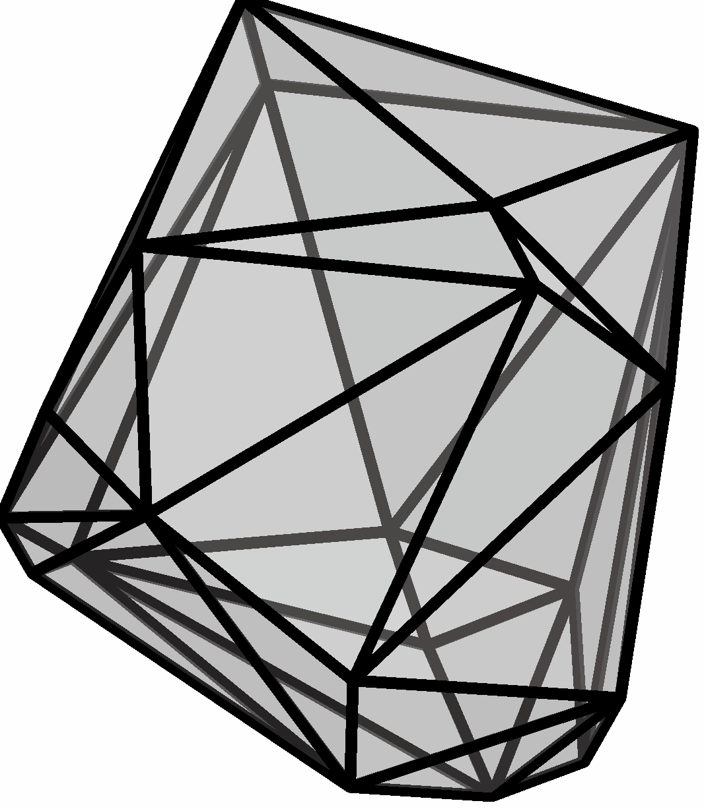
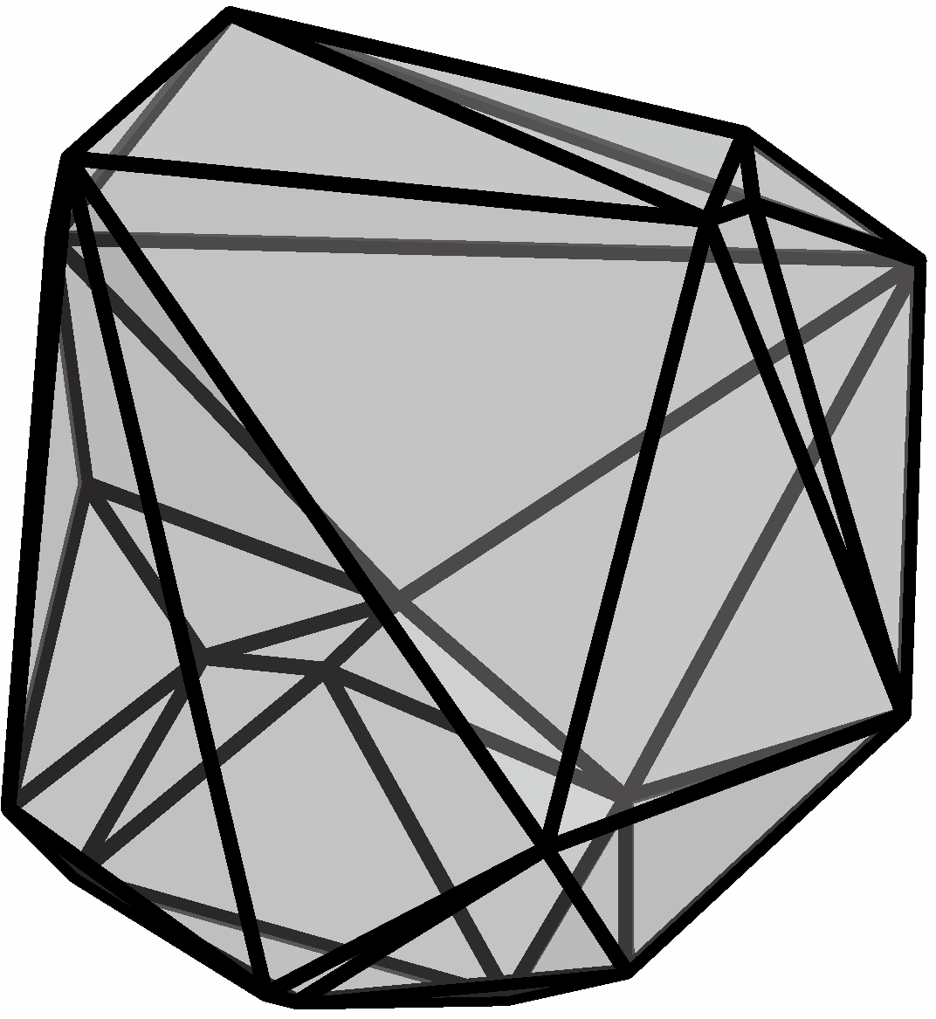
Approaches to Solving Dürer’s Problem
Method 1
(Negative)
Find a convex polyhedron such that all its edge unfoldings result in overlaps.
Edge unfolding
[My PhD Thesis]
Only overlapping edge unfoldings
Method 2
(Positive)
Develop an edge-unfolding algorithm that avoids overlaps for all convex polyhedra.
Algorithm
All convex polyhedra
Non-overlapping unfolding

Slide 9
Planned Approach for Method 2
Edge-Unfolding Algorithm Based on Division and Merging
Division
Unfold
Merging
Current Phase
Next Phase
Long-Term Phase
Starting soon…
After 5–6 years
Key point of this algorithm
There is a trade-off between division and edge unfolding.
If we divide too much → Merging becomes complex.
If we divide too little → Need to design algorithms for a huge number of polyhedra.

Slide 10
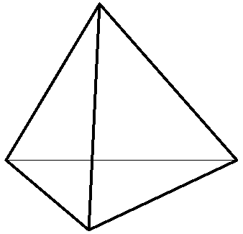
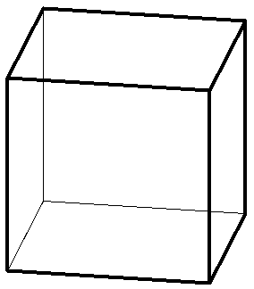
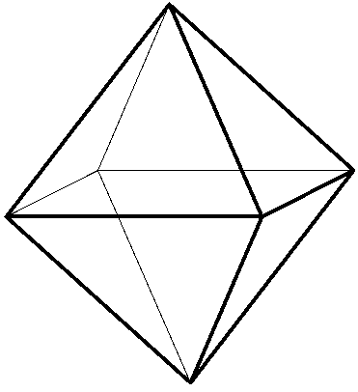
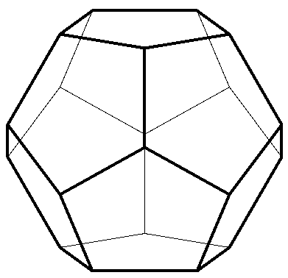
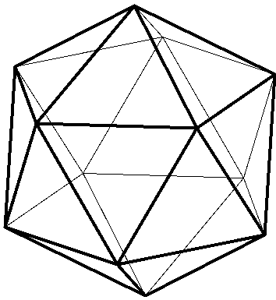
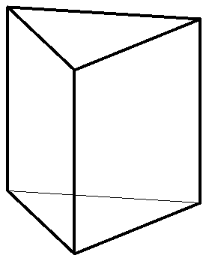
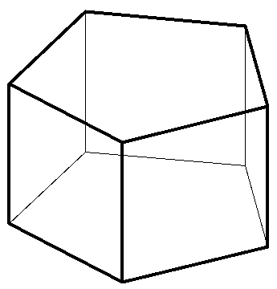
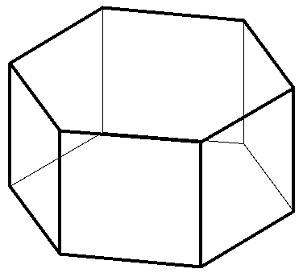
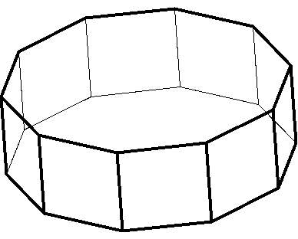
What Are Good Division Strategies?
Strategy 1
Dividing edge-overlap-free polyhedra
Definition 3 [T. Kamata, T. Shiota and R. Uehara, 2024]
A polyhedron is called edge-overlap-free if all of its edge unfoldings are free of overlaps.
[Ex.] All of the following polyhedra are edge-overlap-free.
Platonic solid
[T. Horiyama and W. Shoji, 2011]
Regular 3- to 10-gonal prisms (h > 0)
[T. Kamata et al., 2025 (in Japanese only)]
Edge-overlap-free polyhedra are easy to handle because their faces can be rearranged freely at the merging phase.

Slide 11
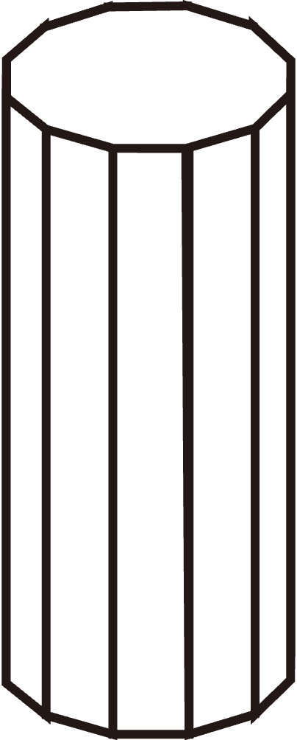
What Are Good Division Strategies?
Strategy 2
Dividing polyhedra with various unfolding methods
[Ex.] Following unfoldings of a prism results in no overlaps.
Polyhedra with various unfolding methods are relatively easy to handle because their faces can be rearranged flexibly.
We aim to characterize which polyhedra are edge-overlap-free and which ones have various unfolding methods.
➡︎ As a first step, we conducted a categorization of polyhedra.

Slide 12
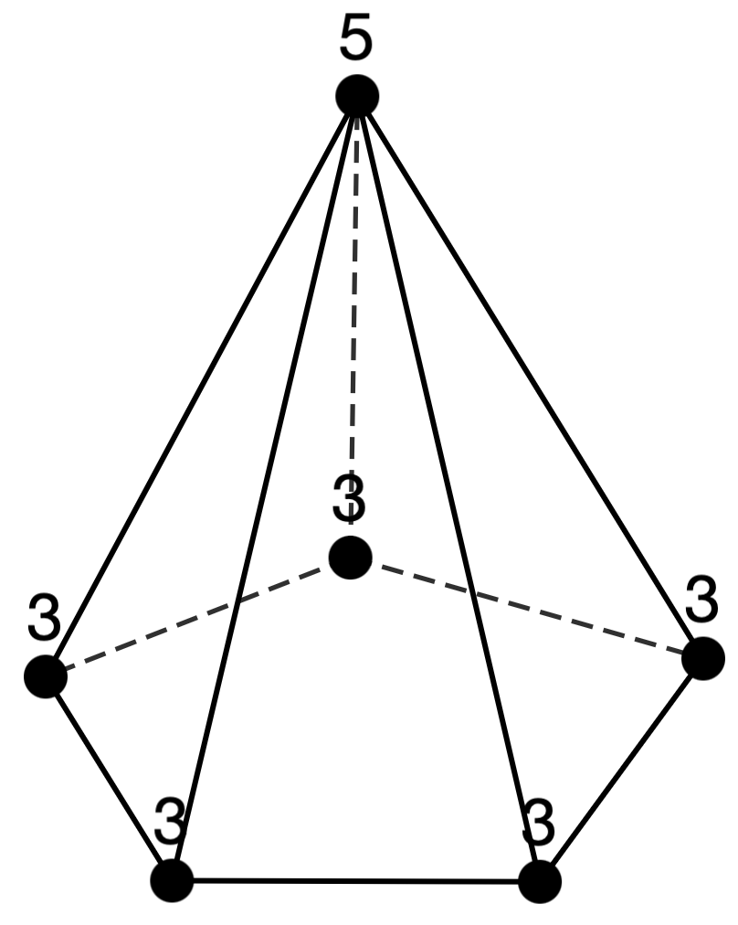
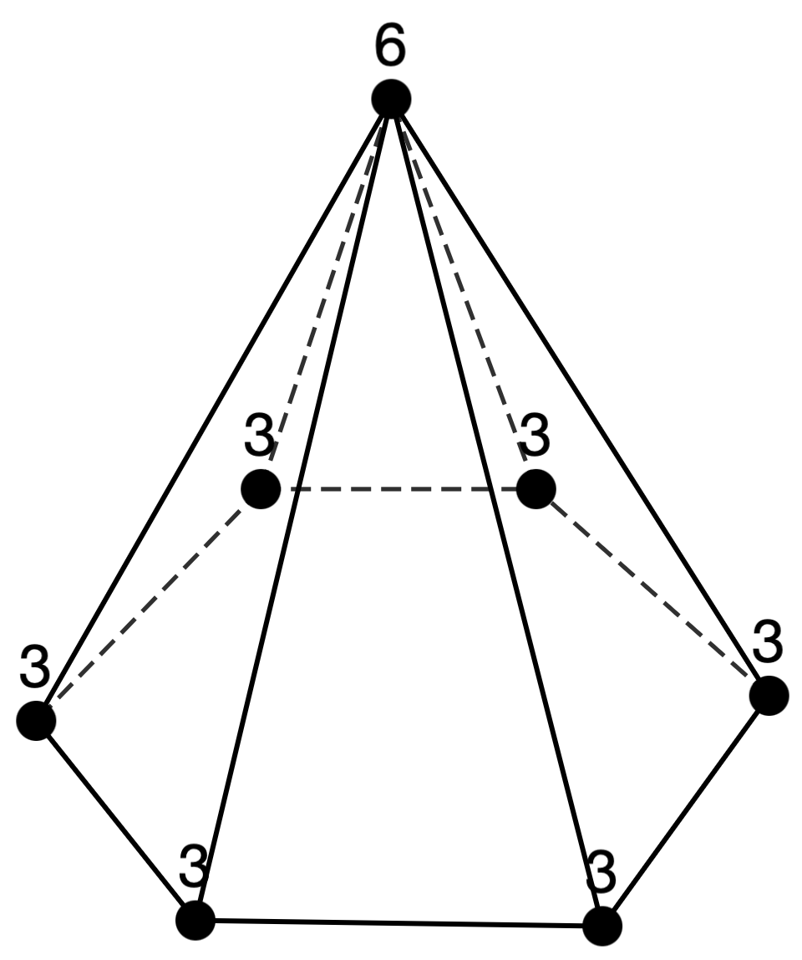
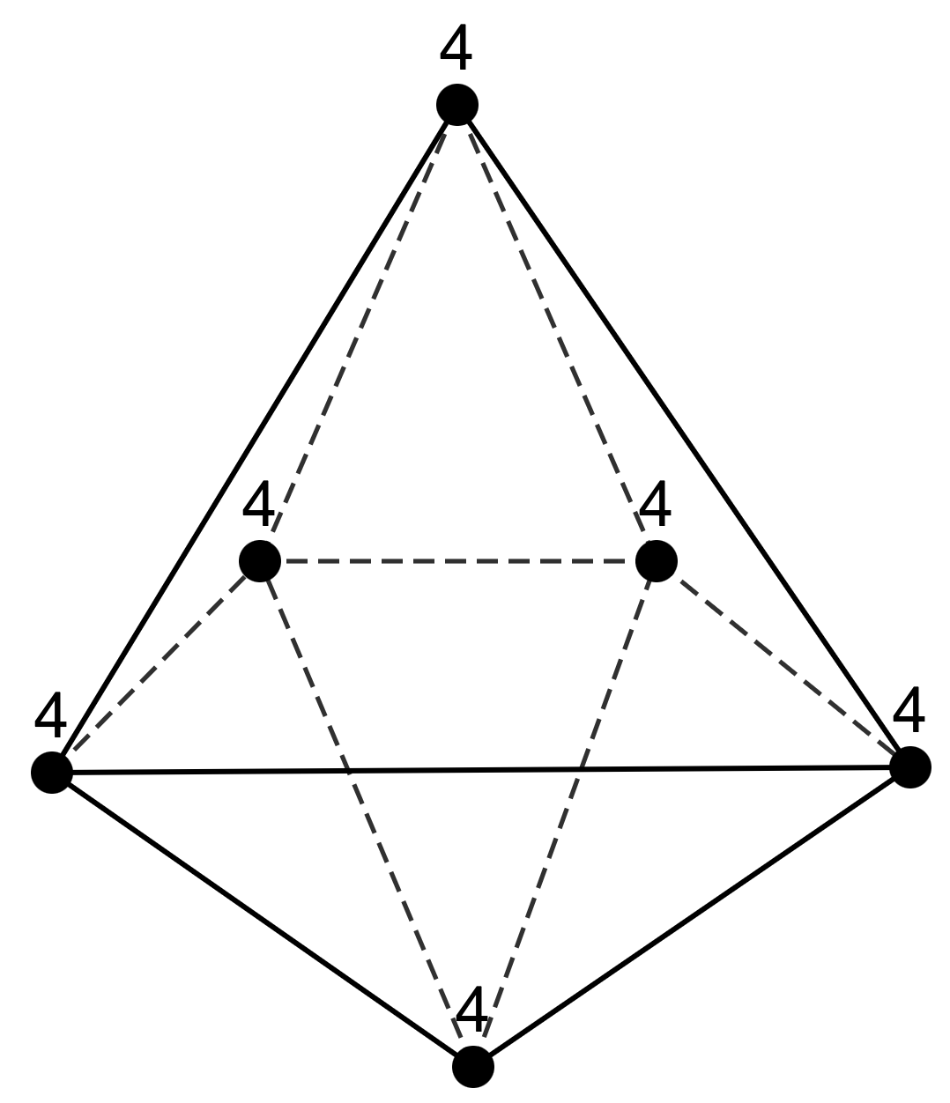
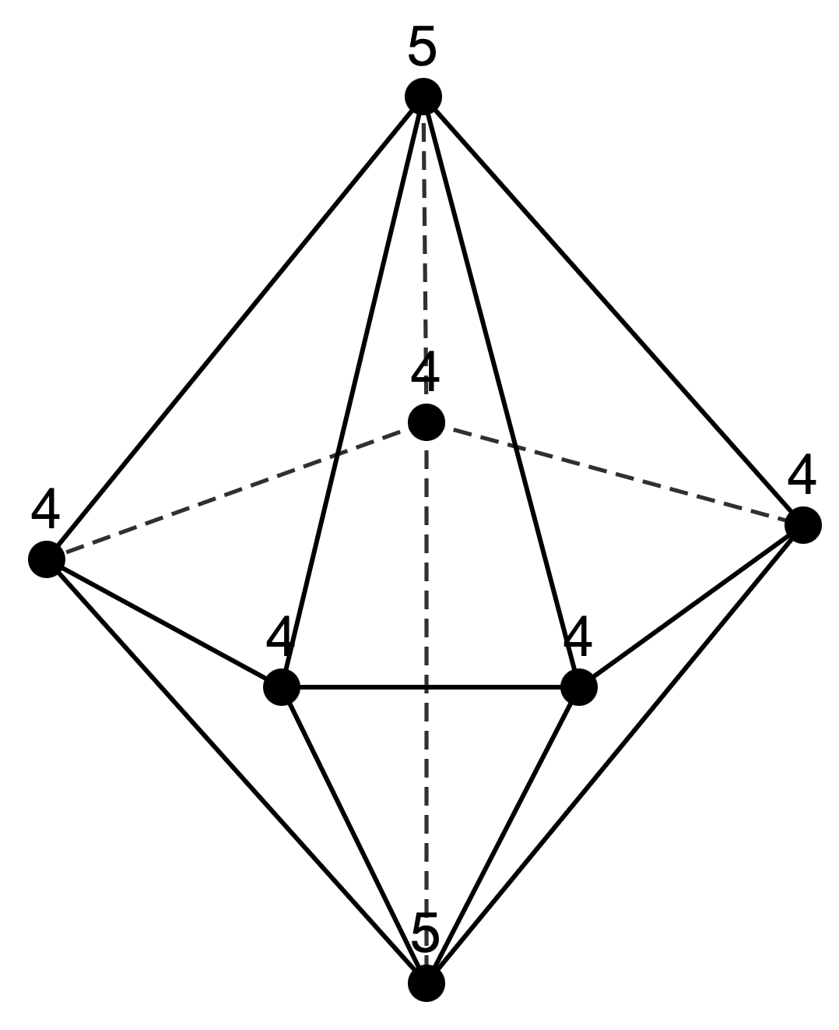
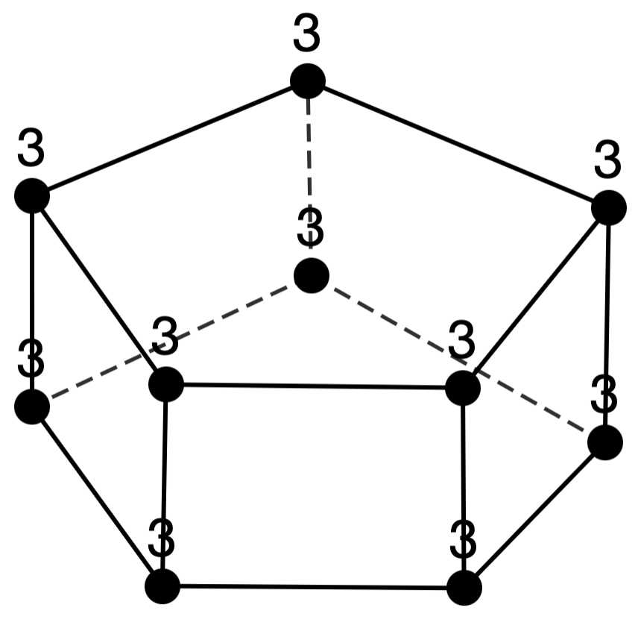
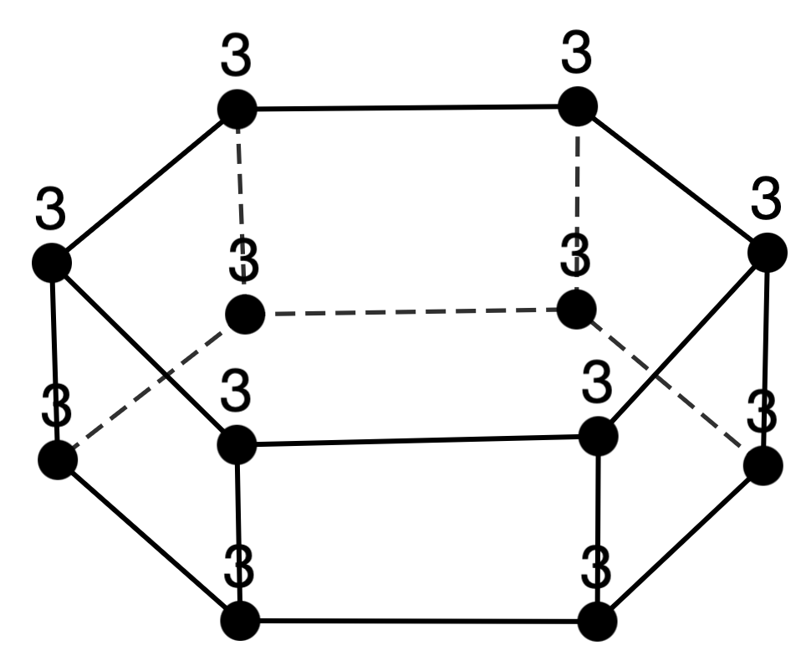

Focused Points in the Categorization
When a polyhedron is divided into a single part, the resulting cutting plane forms an $n$-gon.
+
Well-known polyhedra show vertex counts increasing by 1 or 2.
Pyramid
Bipyramid
Prism
We extracted series of polyhedral graphs for each number of vertices, based on shared structural characteristics.

Slide 13
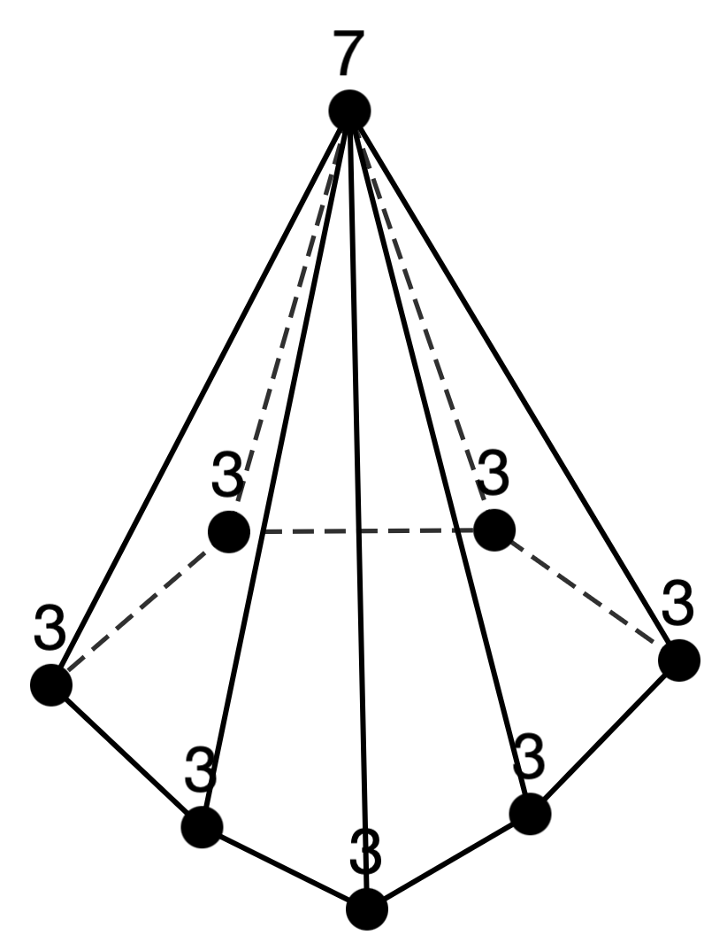
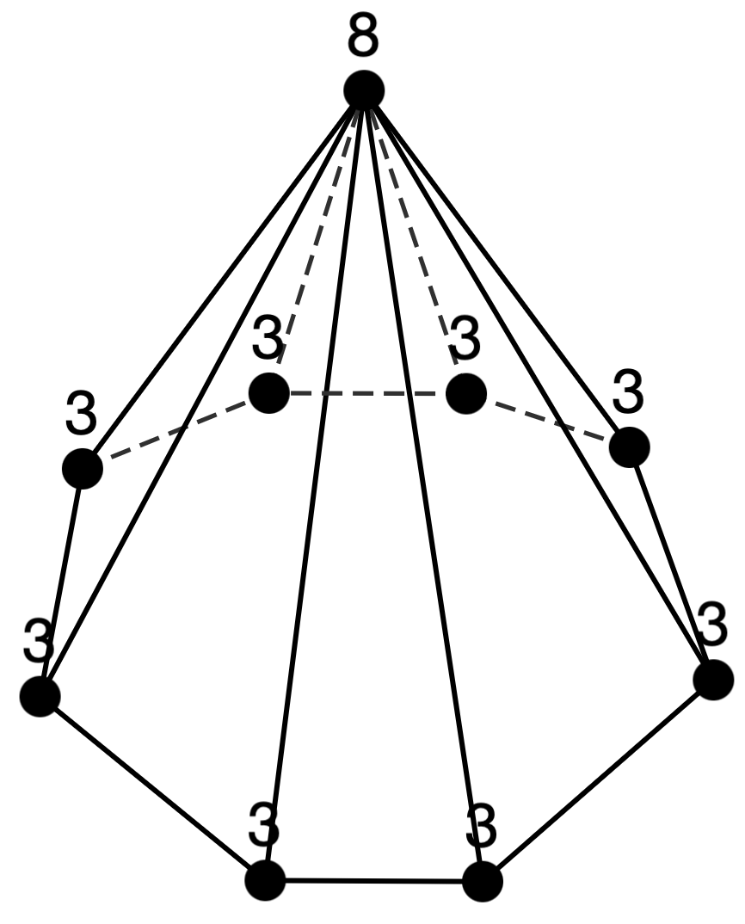
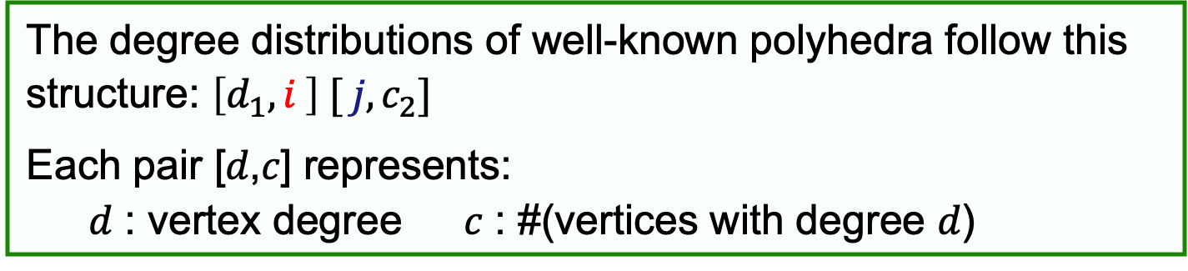
Focused Structural Characteristics
Observation
The degree distributions of well-known polyhedra follow this structure: $\left[d_{1}, i \right] [ j, c_{2}]$
Each pair [𝑑,𝑐] represents:
𝑑 : vertex degree 𝑐 : #(vertices with degree 𝑑)
Pyramid
n=4: [3,3][3,1]
n=5: [3,4][4,1]
n=6: [3,5][5,1]
n=7: [3,6][6,1]
n=8: [3,7][7,1]
n=9: [3,8][8,1]
n=10: [3,9][9,1]
When 𝑛 increases by 1, the values increase stepwise by 1.

Slide 14
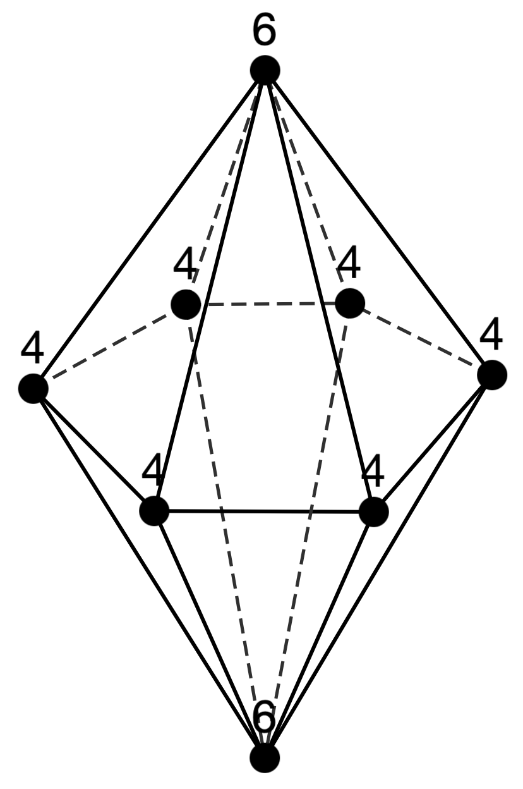
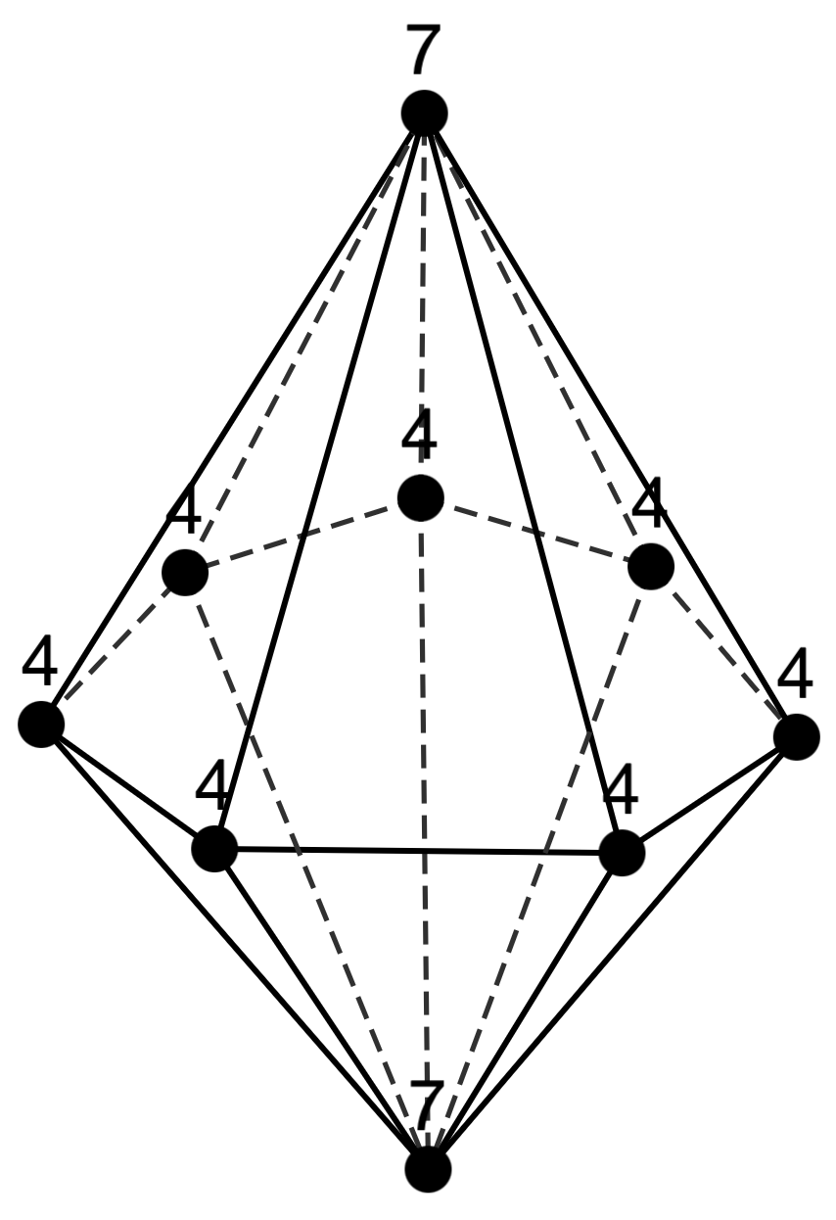
Focused Structural Characteristics
Observation
The degree distributions of well-known polyhedra follow this structure: $\left[d_{1}, i \right] [ j, c_{2}]$
Each pair [𝑑,𝑐] represents:
𝑑 : vertex degree 𝑐 : #(vertices with degree 𝑑)
Bipyramid
n=5: [4,3][3,2]
n=6: [4,4][4,2]
n=7: [4,5][5,2]
n=8: [4,6][6,2]
n=9: [4,7][7,2]
n=10: [4,8][8,2]
n=11: [4,9][9,2]

Slide 15
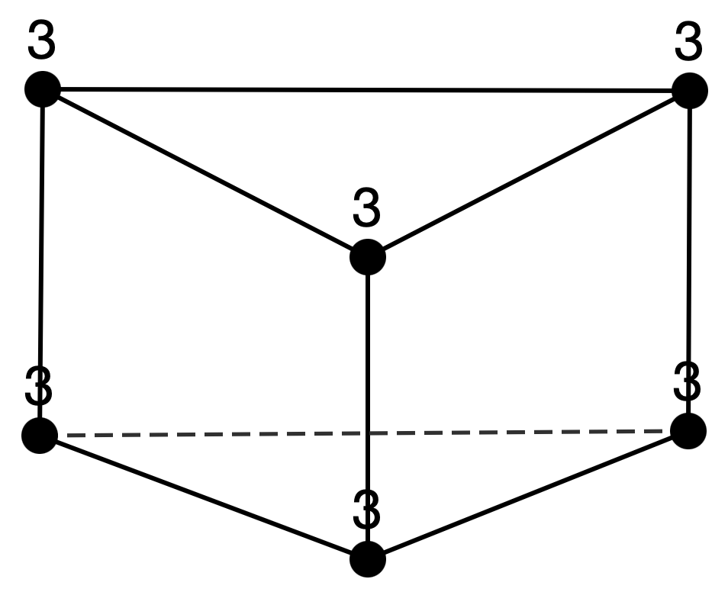
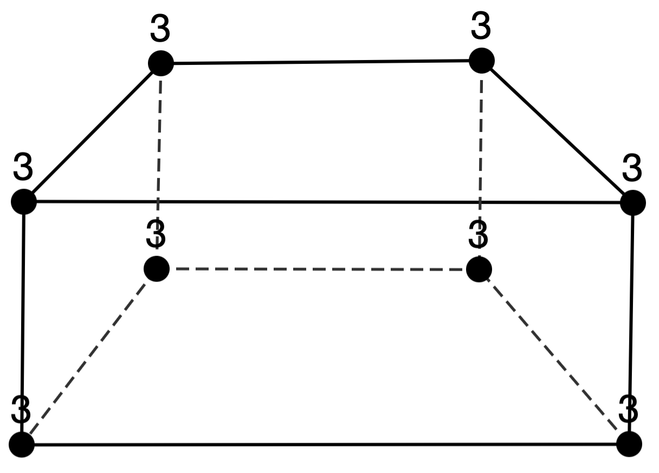
Focused Structural Characteristics
Observation
The degree distributions of well-known polyhedra follow this structure: $\left[d_{1}, i \right] [ j, c_{2}]$
Each pair [𝑑,𝑐] represents:
𝑑 : vertex degree 𝑐 : #(vertices with degree 𝑑)
Prism
n=6: [3,6]
n=8: [3,8]
n=10: [3,10]
n=12: [3,12]
When 𝑛 increases by 2, the values increase stepwise by 2.
From these observations…
We focus on sequences of the form $\left[d_{1}, c_{1}\right]…\left[d_{n−1}, i \right] [ j, c_{n}]$.

Slide 16
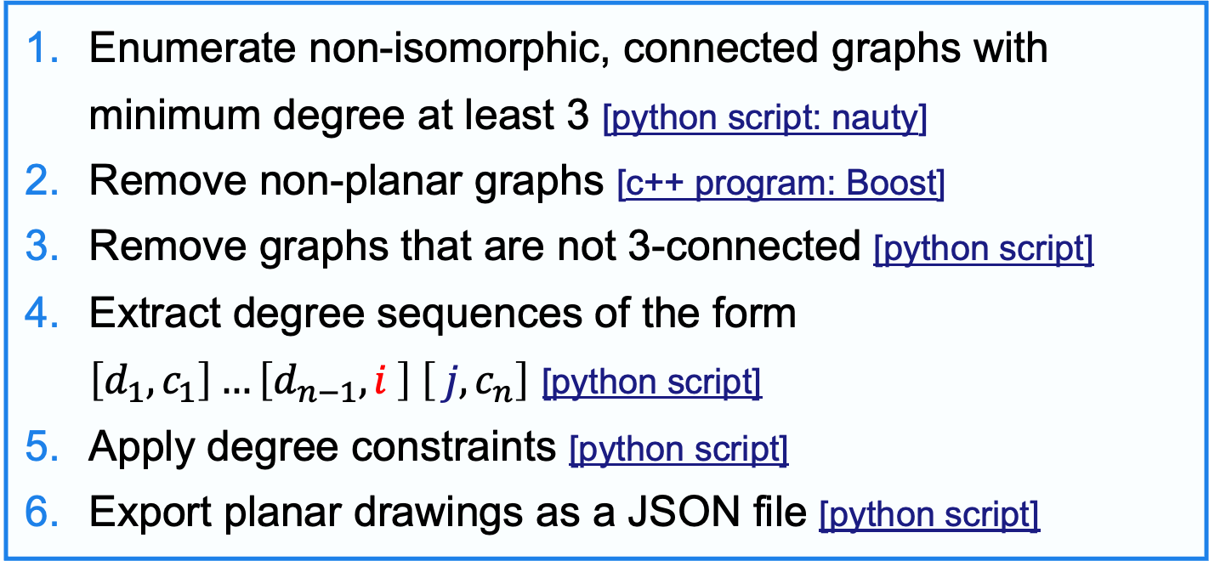
Enumeration of Sequences
Program flow
Enumerate non-isomorphic, connected graphs with minimum degree at least 3 [python script: nauty]
Remove non-planar graphs [c++ program: Boost]
Remove graphs that are not 3-connected [python script]
Extract degree sequences of the form $\left[d_{1}, c_{1}\right]…\left[d_{n−1}, i \right] \left[ j, c_{n}\right]$ [python script]
Apply degree constraints [python script]
Export planar drawings as a JSON file [python script]
The entire program is available at:
https://github.com/ShiotaTakumi/UM2025/tree/main/src/geng_boost

Slide 17
List of obtained [deg., cnt.] sequences
Sequence 1
Sequence 2
n=6: [3,3][4,2][5,1]
n=7: [3,4][4,2][6,1]
n=8: [3,5][4,2][7,1]
n=9: [3,6][4,2][8,1]
n=10: [3,7][4,2][9,1]
n=11: [3,8][4,2][10,1]
n=7: [3,6][4,1]
n=8: [3,7][5,1]
n=9: [3,8][6,1]
n=10: [3,9][7,1]
n=11: [3,10][8,1]
Sequence 3
Sequence 4
n=7: [3,3][4,3][5,1]
n=8: [3,4][4,3][6,1]
n=9: [3,5][4,3][7,1]
n=10: [3,6][4,3][8,1]
n=11: [3,7][4,3][9,1]
n=7: [3,1][4,5][5,1]
n=8: [3,2][4,5][6,1]
n=9: [3,3][4,5][7,1]
n=10: [3,4][4,5][8,1]
n=11: [3,5][4,5][9,1]

Slide 18
List of obtained [deg., cnt.] sequences
Sequence 5
Sequence 6
n=7: [3,2][4,2][5,2][6,1]
n=8: [3,3][4,2][5,2][7,1] n=9: [3,4][4,2][5,2][8,1] n=10: [3,5][4,2][5,2][9,1]
n=11: [3,6][4,2][5,2][10,1]
n=7: [3,2][4,4][6,1]
n=8: [3,3][4,4][7,1]
n=9: [3,4][4,4][8,1]
n=10: [3,5][4,4][9,1]
n=11: [3,6][4,4][10,1]
Sequence 7
Sequence 8
n=7: [3,3][5,3][6,1]
n=8: [3,4][5,3][7,1]
n=9: [3,5][5,3][8,1]
n=10: [3,6][5,3][9,1]
n=11: [3,7][5,3][10,1]
n=7: [3,2][4,2][5,2][6,1]
n=8: [3,2][4,2][5,3][7,1]
n=9: [3,2][4,2][5,4][8,1]
n=10: [3,2][4,2][5,5][9,1]
n=11: [3,2][4,2][5,6][10,1]

Slide 19
List of obtained [deg., cnt.] sequences
Sequence 9
Sequence 10
n=8: [3,4][4,2][5,2]
n=9: [3,4][4,3][6,2]
n=10: [3,4][4,4][7,2]
n=11: [3,4][4,5][8,2]
n=8: [3,3][4,4][5,1]
n=9: [3,4][4,4][6,1]
n=10: [3,5][4,4][7,1]
n=11: [3,6][4,4][8,1]
Sequence 11
Sequence 12
n=8: [3,5][4,2][5,1]
n=9: [3,6][4,2][6,1]
n=10: [3,7][4,2][7,1]
n=11: [3,8][4,2][8,1]
n=8: [3,3][4,3][5,1][6,1]
n=9: [3,3][4,3][5,2][7,1]
n=10: [3,3][4,3][5,3][8,1]
n=11: [3,3][4,3][5,4][9,1]

Slide 20
List of obtained [deg., cnt.] sequences
Sequence 13
Sequence 14
n=8: [3,2][4,3][5,2][6,1]
n=9: [3,3][4,3][5,2][7,1]
n=10: [3,4][4,3][5,2][8,1]
n=11: [3,5][4,3][5,2][9,1]
n=8: [3,2][4,3][5,2][6,1]
n=9: [3,2][4,3][5,3][7,1]
n=10: [3,2][4,3][5,4][8,1]
n=11: [3,2][4,3][5,5][9,1]
Sequence 15
Sequence 16
n=8: [3,3][4,2][5,1][6,2]
n=9: [3,3][4,3][5,1][7,2]
n=10: [3,3][4,4][5,1][8,2]
n=11: [3,3][4,5][5,1][9,2]
n=8: [3,4][4,2][5,1][7,1]
n=9: [3,4][4,2][5,2][8,1]
n=10: [3,4][4,2][5,3][9,1]
n=11: [3,4][4,2][5,4][10,1]

Slide 21
List of obtained [deg., cnt.] sequences
Sequence 17
Sequence 18
n=8: [3,4][4,2][6,2]
n=9: [3,4][4,3][7,2]
n=10: [3,4][4,4][8,2]
n=11: [3,4][4,5][9,2]
n=8: [3,3][4,2][5,2][7,1]
n=9: [3,3][4,2][5,3][8,1]
n=10: [3,3][4,2][5,4][9,1]
n=11: [3,3][4,2][5,5][10,1]
Sequence 19
Sequence 20
n=8: [3,1][4,6][5,1]
n=9: [3,2][4,6][6,1]
n=10: [3,3][4,6][7,1]
n=11: [3,4][4,6][8,1]
n=8: [3,2][4,4][5,1][7,1]
n=9: [3,2][4,4][5,2][8,1]
n=10: [3,2][4,4][5,3][9,1]
n=11: [3,2][4,4][5,4][10,1]

Slide 22
List of obtained [deg., cnt.] sequences
Sequence 21
Sequence 22
n=8: [3,1][4,3][5,3][6,1]
n=9: [3,2][4,3][5,3][7,1]
n=10: [3,3][4,3][5,3][8,1]
n=11: [3,4][4,3][5,3][9,1]
n=8: [3,1][4,4][5,1][6,2]
n=9: [3,1][4,5][5,1][7,2]
n=10: [3,1][4,6][5,1][8,2]
n=11: [3,1][4,7][5,1][9,2]
Sequence 23
n=8: [3,2][4,2][5,3][7,1]
n=9: [3,3][4,2][5,3][8,1]
n=10: [3,4][4,2][5,3][9,1]
n=11: [3,5][4,2][5,3][10,1]

Slide 23
List of obtained [deg., cnt.] sequences
Sequence 24
Sequence 25
n=6: [3,3][4,2][5,1]
n=8: [3,3][4,4][7,1]
n=10: [3,3][4,6][9,1]
n=6: [3,4][4,2]
n=8: [3,6][5,2]
n=10: [3,8][6,2]
Sequence 26
Sequence 27
n=7: [3,3][4,3][5,1]
n=9: [3,3][4,5][7,1]
n=11: [3,3][4,7][9,1]
n=7: [3,2][4,3][5,2]
n=9: [3,4][4,3][6,2]
n=11: [3,6][4,3][7,2]
Sequence 28
Sequence 29
n=7: [3,4][4,1][5,2]
n=9: [3,4][4,3][6,2]
n=11: [3,4][4,5][7,2]
n=7: [3,4][4,1][5,2]
n=9: [3,6][4,1][6,2]
n=11: [3,8][4,1][7,2]

Slide 24
List of obtained [deg., cnt.] sequences
Sequence 30
Sequence 31
n=7: [3,4][4,2][6,1]
n=9: [3,4][4,4][8,1]
n=11: [3,4][4,6][10,1]
n=7: [3,5][4,1][5,1]
n=9: [3,5][4,3][7,1]
n=11: [3,5][4,5][9,1]
Sequence 32
Sequence 33
n=7: [3,2][4,2][5,2][6,1]
n=9: [3,2][4,4][5,2][8,1]
n=11: [3,2][4,6][5,2][10,1]
n=7: [3,2][4,3][6,2]
n=9: [3,4][4,3][7,2]
n=11: [3,6][4,3][8,2]
Sequence 34
n=7: [3,2][4,4][6,1]
n=9: [3,2][4,6][8,1]
n=11: [3,2][4,8][10,1]

Slide 25
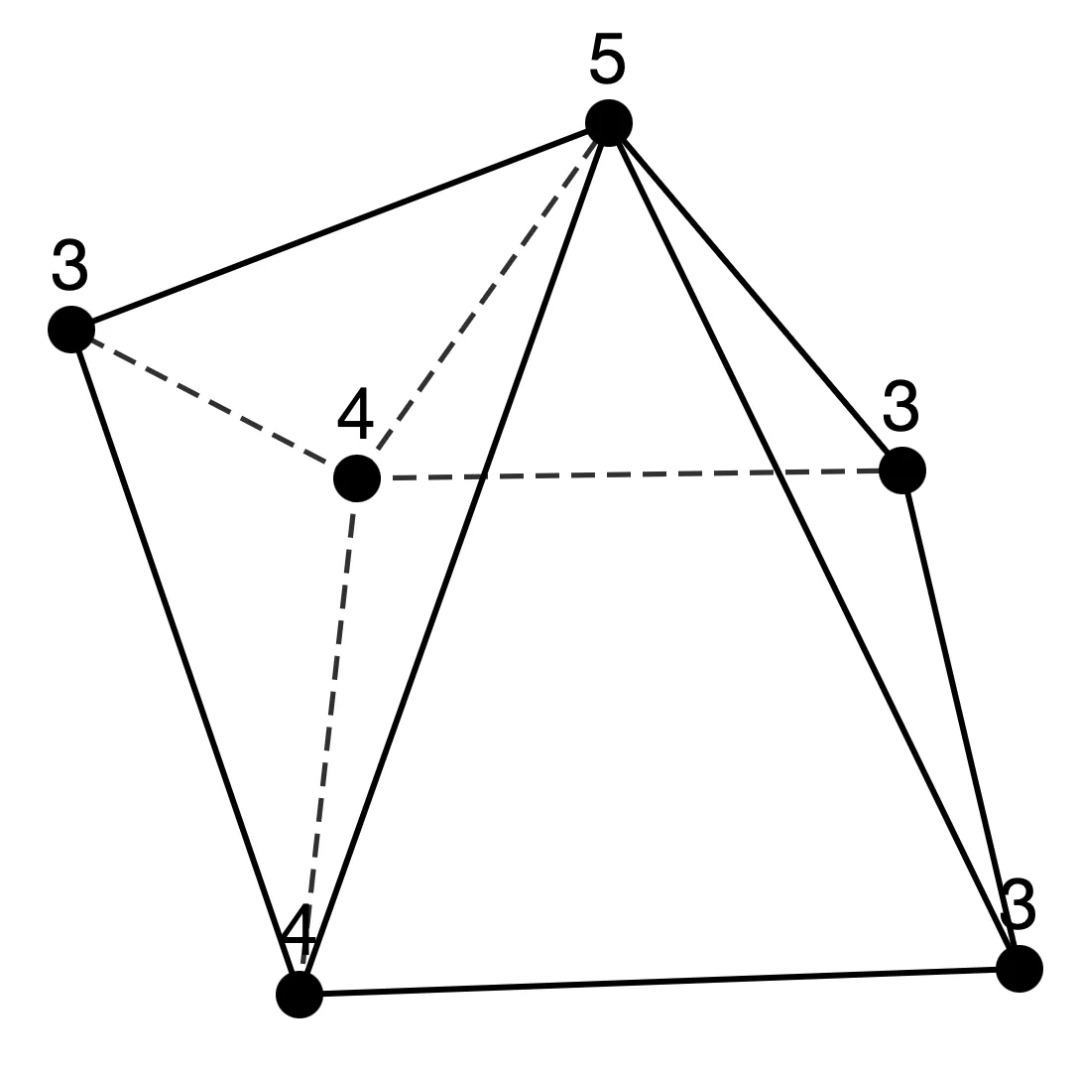
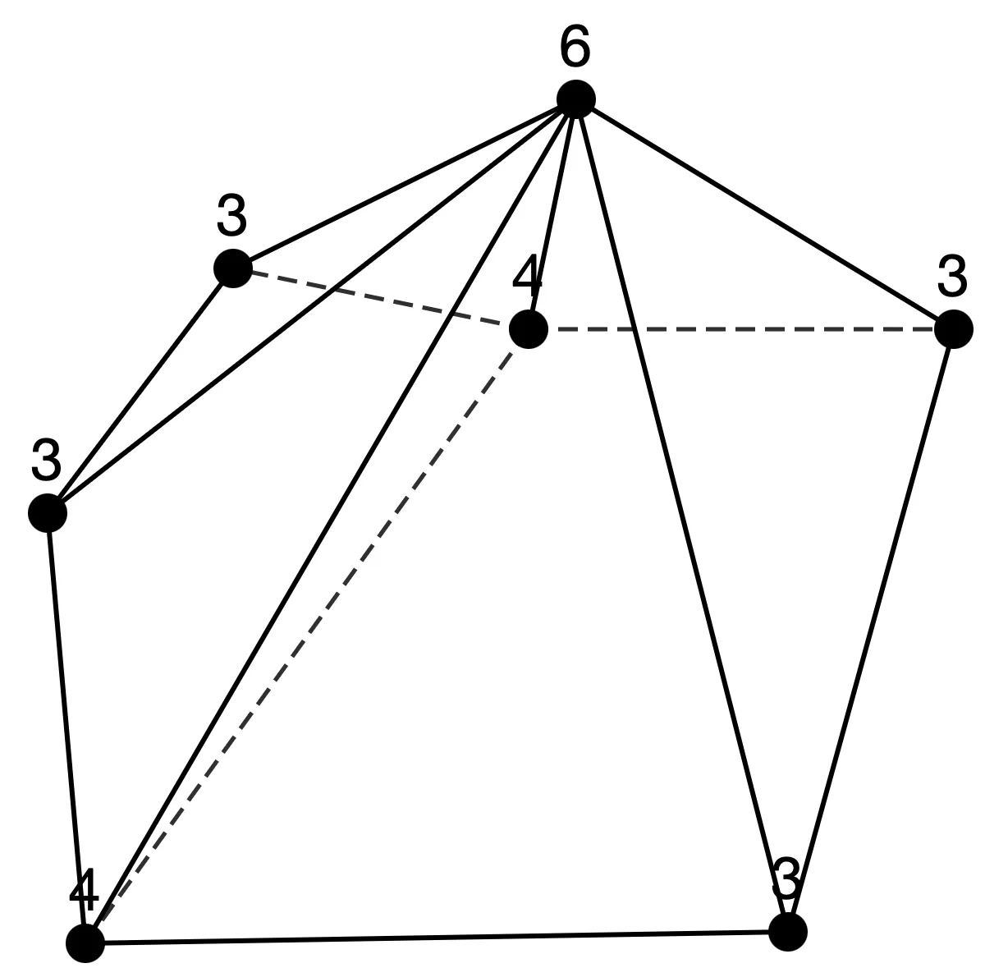
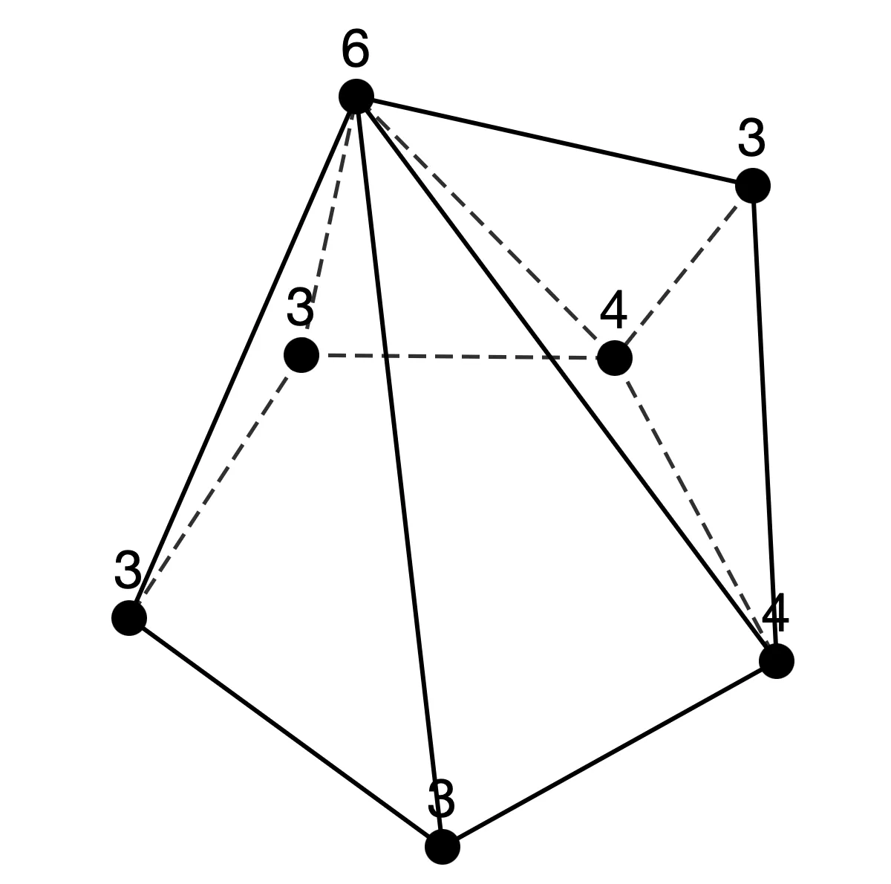
Sequence 1
n=6: [3,3][4,2][5,1]
n=7: [3,4][4,2][6,1]
n=8: [3,5][4,2][7,1]
n=9: [3,6][4,2][8,1]
n=10: [3,7][4,2][9,1]
n=11: [3,8][4,2][10,1]
n = 6 (1 type)
n = 7 (2 types)
①
①
②
①
①

Slide 26
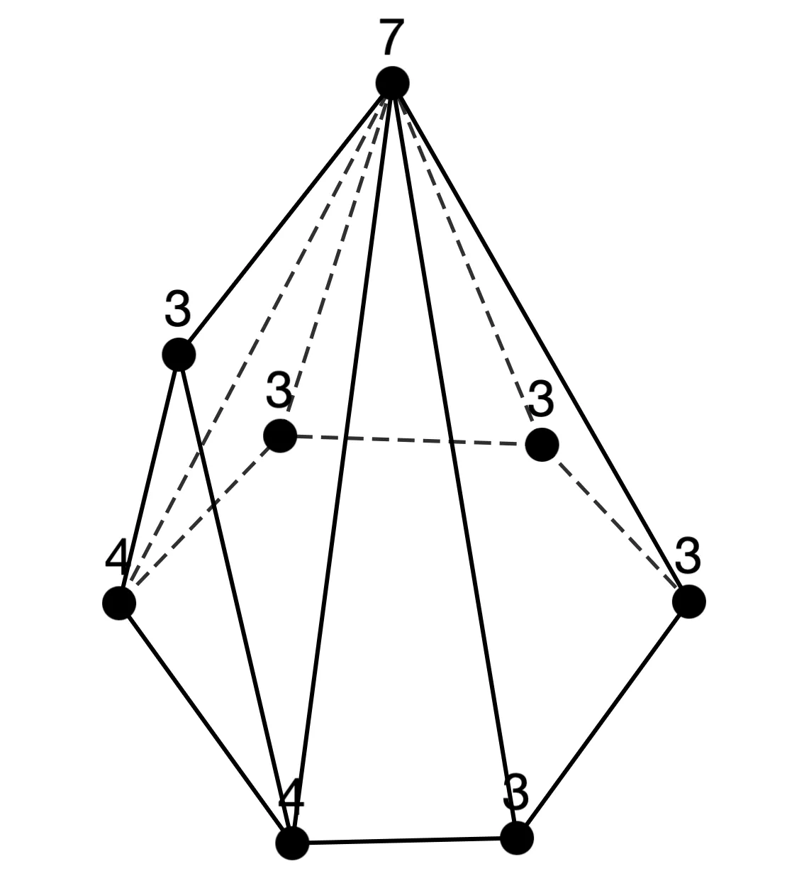
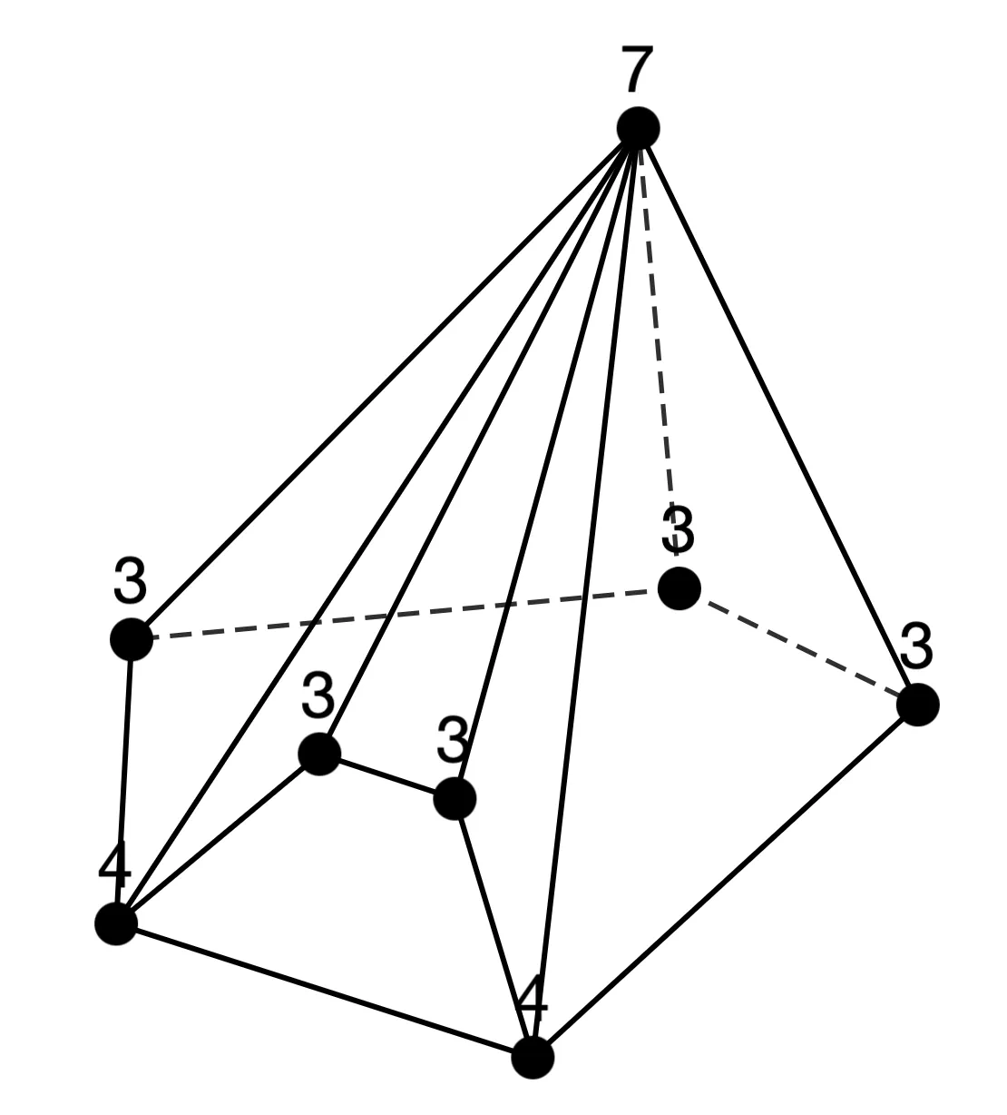



Sequence 1
n = 8 (2 types)
①
②
②
① ②
n = 9 (3 types)
①
②
③
①
②
①

Slide 27







Sequence 1
n = 10 (3 types)
①
②
③
③
②
①
n = 11 (4 types)
①
②
③
④
②
① ③
② ③
①

Slide 28



Sequence 2
n=6: [3,5][3,1] (=[3,6])
n=7: [3,6][4,1]
n=8: [3,7][5,1]
n=9: [3,8][6,1]
n=10: [3,9][7,1]
n=11: [3,10][8,1]
n = 6 (1 type)
n = 7 (2 types)
①
①
②
①

Slide 29





Sequence 2
n = 8 (2 types)
①
②
②
②
n = 9 (3 types)
①
②
③
②
②
①

Slide 30



Sequence 2
n = 10 (3 types)
①
②
③
②
③
①

Slide 31




Sequence 2
n = 11 (4 types)
①
②
②
①
③
④
②
③

Slide 32




Sequence 5
n=7: [3,2][4,2][5,2][6,1]
n=8: [3,3][4,2][5,2][7,1] n=9: [3,4][4,2][5,2][8,1] n=10: [3,5][4,2][5,2][9,1]
n=11: [3,6][4,2][5,2][10,1]
n = 7 (1 type)
n = 8 (3 types)
①
①
②
③
①
①

Slide 33






Sequence 5
n = 9 (9 types)
①
②
③
①
③
②
④
⑤
⑥
③
②
②

Slide 34



Sequence 5
n = 9 (continued)
⑦
⑧
⑨
③
①
①

Slide 35






Sequence 5
n = 10 (17 types)
①
②
③
⑤
②
①
④
⑤
⑥
① ⑨
②
③

Slide 36






Sequence 5
n = 10 (continued)
⑦
⑧
⑨
⑤
③ ⑤
④ ⑦
⑩
⑪
⑫
② ④ ⑨
⑤ ⑥
⑦ ⑨

Slide 37




Sequence 5
n = 10 (continued)
⑬
⑭
⑮
⑧
⑧ ⑨
⑦
⑯
⑰
⑥
③

Slide 38



Sequence 6
n=7: [3,2][4,4][6,1]
n=8: [3,3][4,4][7,1]
n=9: [3,4][4,4][8,1]
n=10: [3,5][4,4][9,1]
n=11: [3,6][4,4][10,1]
n = 7 (1 type)
n = 8 (2 types)
①
①
②
①
①

Slide 39





Sequence 6
n = 9 (5 types)
①
②
③
①
②
②
④
⑤
②

Slide 40








Sequence 6
n = 10 (8 types)
①
②
③
④
① ② ④
⑤
⑤
③
⑤
⑥
⑦
⑧
⑤
④
④
③ ④

Slide 41




Sequence 7
n=7: [3,3][5,3][6,1]
n=8: [3,4][5,3][7,1]
n=9: [3,5][5,3][8,1]
n=10: [3,6][5,3][9,1]
n=11: [3,7][5,3][10,1]
n = 7 (1 type)
①
n = 8 (1 type)
n = 9 (2 types)
①
①
②
①
①
①

Slide 42







Sequence 7
n = 10 (3 types)
①
②
③
①
②
②
n = 11 (4 types)
①
②
③
④
②
①
① ③
② ③

Slide 43


Sequence 8
n=6: [3,2][4,2][5,1][5,1]
n=7: [3,2][4,2][5,2][6,1]
n=8: [3,2][4,2][5,3][7,1]
n=9: [3,2][4,2][5,4][8,1]
n=10: [3,2][4,2][5,5][9,1]
n=11: [3,2][4,2][5,6][10,1]
n = 6 (1 type)
n = 7 (1 type)
①
①
①
n = 8 (1 type)
n = 9 (1 type)
n = 10 (1 type)
n = 11 (1 type)
①
①
①
①
①
①
①
①

Slide 44

Conclusion
We classified polyhedral graphs based on degree distributions and successfully visualized various series.
Future works
The visualization of all sequences is not yet complete. ➡︎ We will continue exploring other interesting sequences.
Due to hardware limits, exploration is currently up to $n=11$. ➡︎ We aim to extend this to $n = 12$ and search for interesting sequences where $n = 8→ 10→ 12$.
Sometimes, expected polyhedral graphs do not appear. ➡︎ We aim to provide explanations for why such polyhedral graphs do not exist.

Slide 45
Missing Expected Polyhedral graphs
Sequence 1
n = 7 (2 types)
n = 8 (2 types)
①
②
①
②
②
① ②
Sequence 2
n = 7 (2 types)
n = 8 (2 types)
①
②
①
②
②
②

